Slide 1

PAC on PARTICLE PHYSICS
36th meeting, January 23-24, 2012
Recommandations and work towards the optimisation of the research programme
Egle Tomasi-Gustafsson
Scientific Council, Dubna, 16/II/2012

Slide 2
II. Recommendations on the Nuclotron-NICA projects
G. Trubnikov
The PAC congratulates the team for the significant progress achieved in modernization of the VBLHEP accelerating complex, especially the very productive Run 44 (November-December 2011) of the Nuclotron.

Slide 3

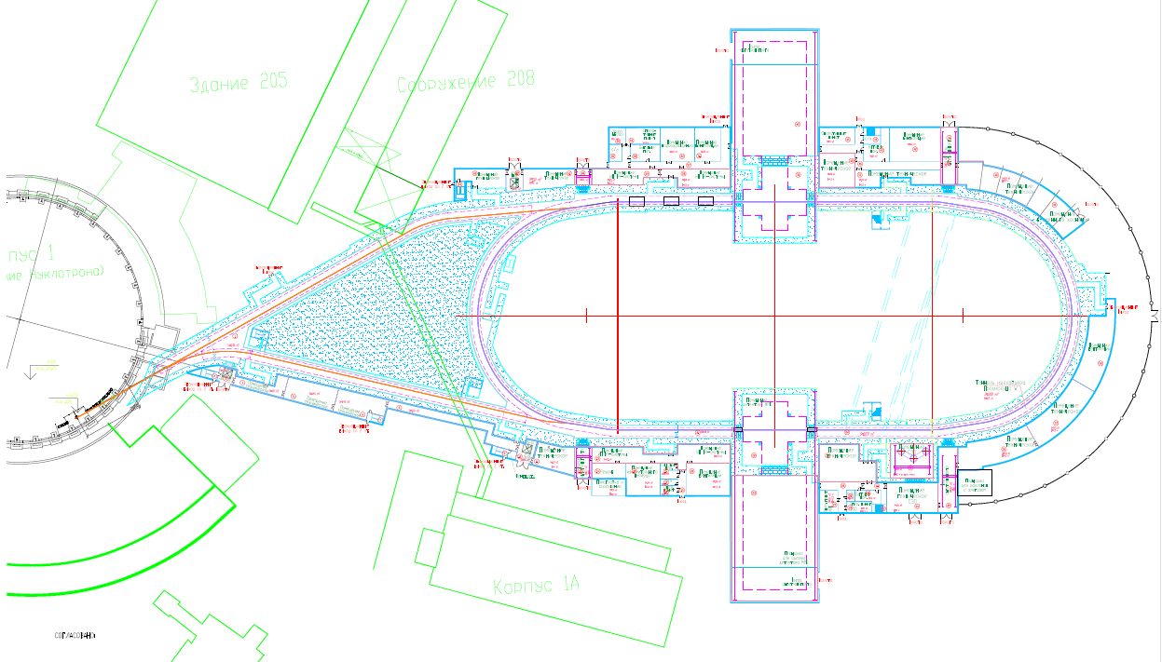
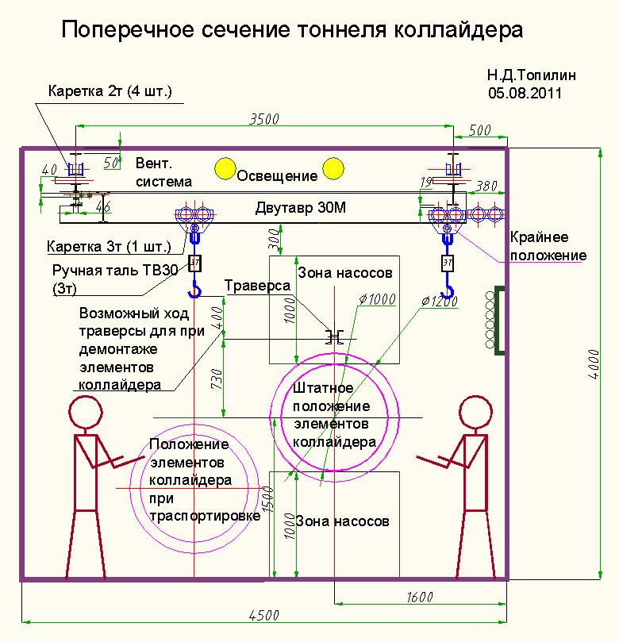
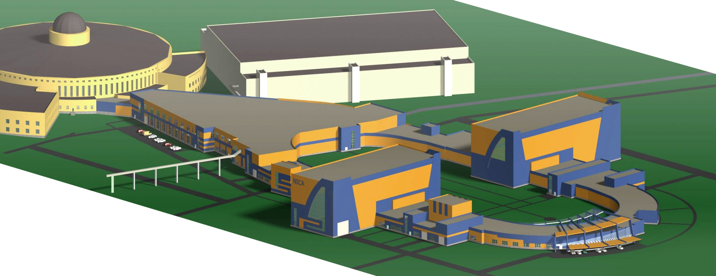


NICA complex technical design report status
Composition of buildings, technical systems, main equipment on the technical ground of LHEP – “KOMETA”, GSPI
G. Trubnikov
ALL geological, geodetical, topography measurements and drillings had been fulfilled and analyzed. Technological part of the TDR (main equipment, engineering systems, etc), radiation and environmental safety, architecture had been fulfilled. Now – the final stage: capital spending sights. Plan – to submit all documents to the State Expertise – February 2012.
31/34

Slide 4
Nuclotron run #44 results
Run # 44 – is for now the longest run in Nuclotron history: 1230 hours.
for the first time we had room-temperature half-ring + LHe half-ring
for the first time we tested mode with half warming-up the machine up to LN (77K) temperature and after cooled (36 h)
For the first time at Nuclotron had been performed: deuterons and carbon (C6+) had been accelerated up to 4 and 3.5 GeV/u and slow beam extraction had been provided for physicists
400 hours for physicists ~ 75% from planned hours
KVINTA : 85 hours + Gamma-3: 30 hours
(Belarus, Poland, Czech, Greece, Germany, Bolgaria)
MPD-STRELA (MRPC for MPD) (Russia, China, Germany): 70 hours
Delta + DSS (Russia): 100 hours
NIS-GIBS (JINR): 48 hours
SCAN (JINR, Germany): 100 hours (in parallel)
Radiobiology(JINR, IMBP) : 33 hours
BM@N (JINR, Germany): 15 hours
3/28

Slide 5
II. Recommendations on the Nuclotron-NICA projects
G. Trubnikov
The PAC congratulates the team for the significant progress achieved in modernization of the VBLHEP accelerating complex, especially the very productive Run 44 (November-December 2011) of the Nuclotron.
The PAC looks forward to a report from the Run Coordinator on the actual share of the beam delivered to the physics groups.
In the future the PAC wishes to be informed about a more detailed schedule of the project realization (with milestones) until the first NICA collision by 2017.

Slide 6
III. Recommendations on the progress towards the NICA White Paper
A. Sorin
The PAC appreciates the significant amount of work accomplished in this direction.

Slide 7
New Contributions to the NICA White Paper, Draft v 6.02
(last update: 20.01.12)‏
http://theor.jinr.ru/twiki-cgi/view/NICA/WebHome
Section 4: Hydrodynamics and hadronic observables
4.13 Understanding the properties of chemical freeze-out
C. Blume
4.14 Dynamical development of statistical parameters in phase transition
L.P. Csernai, D.J. Wang, C. Anderlik, X. Cai, Y. Cheng, D.M. Zhou
4.15 Challenges to hydrodynamics at NICA
P. Huovinen
Section 6: Mechanisms of multi-particle production
6.7 Statistical production of antikaon nuclear bound states at NICA
A. Andronic, P. Braun-Munzinger, K. Redlich
Section 8: Local P and CP violation in hot QCD matter‏
8.7 Particle correlations and local P-violation in heavy-ion collisions
V. Koch, A. Bzdak, J. Liao
Section 12: Fixed target experiments
12.5 Nuclear and strange matter physics with a ﬁxed-target experiment at
the JINR-Nuclotron
P. Senger
12.6 Deeply Subthreshold Particle Production in Nucleus-Nucleus Collisions
S. Mrowczynski

Slide 8
Planned bilateral NICA-FAIR Workshop* (Frankfurt, April 2012)
Structure of Matter at Highest Baryon Densities in Laboratory and Space (NICA, FAIR, SPS, BES RHIC)
Topics to be covered:
- Phases of QCD at high baryon densities
- Effects signalling phase transitions
- Observables in heavy-ion collisions and in astrophysics
- Simulations of ion collisions and supernovae
Aims:
- identify discovery potential of Nuclotron-NICA and FAIR in the canon of
current and future HIC experiments
- chiral symmetry restoration
- onset of deconfinement
- in-medium modification of hadron properties
- color superconductivity, multiquark states, etc.
Expected results:
- To select most promising and feasible suggestions for experiments at
Nuclotron-NICA
To fix priorities for detectors and formation of international collaborations
* German-Russian Year of Science 2011/2012

Slide 9
III. Recommendations on the progress towards the NICA White Paper
A. Sorin
The PAC appreciates the significant amount of work accomplished in this direction.
Most of the new contributions make use of the parameters of the NICA facility for both the collider (MPD) and the fixed target (BM@N) experiments….specific predictions for the possible outcome for experiment
The PAC is pleased to note the broad international involvement in the preparation of this document, which points to the visibility of this activity in the world view.
The PAC recommends continuation of this important work for shaping the research programmes at NICA/MPD and Nuclotron-NICA.

Slide 10
IV. Recommendations on the MPD project
V. Kekelidze
The PAC appreciates the significant progress achieved in the preparation of the project, noting with satisfaction that the MPD team and Detector Advisory Committee have begun their fruitful collaboration, and looks forward to the preparation of a TDR.
The PAC notes a possible overlap of the schedule for the NICA-MPD and FAIR-CBM experiments, both planned to start in 2017–2018. As JINR physicists are involved in the realization of the heavy-ion programme at FAIR, the PAC considers that this project should be realized within a mutually beneficial collaboration.

Slide 11
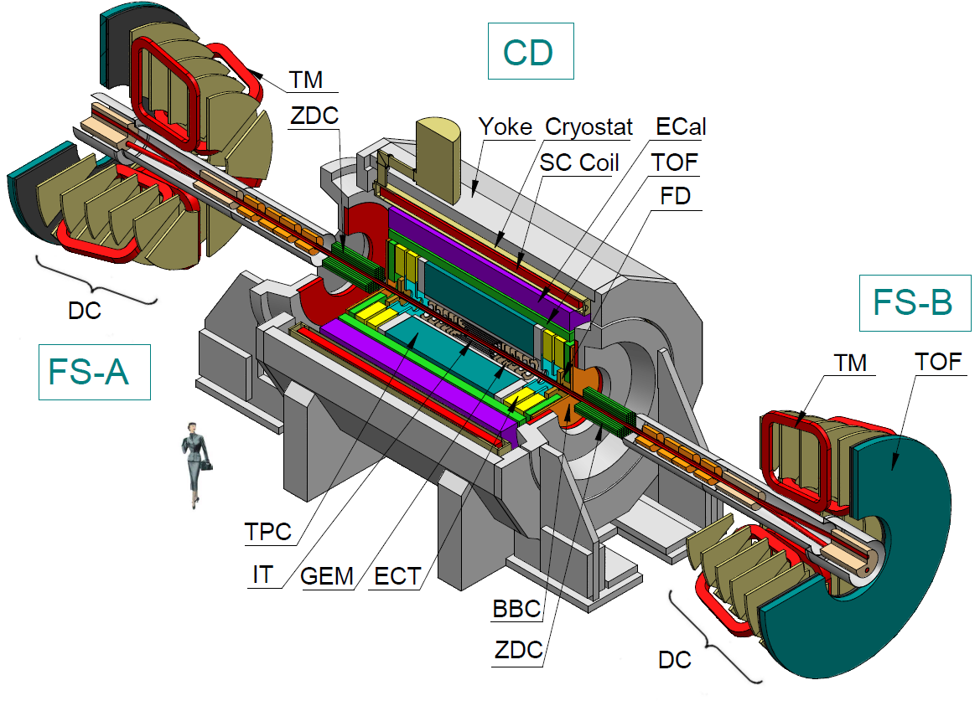
3 stages of putting into operation
V. Kekelidze
2-nd stage
IT,EC-subdetectors,
Forward tracking chambers (GEM,CPC)
3-d stage
F-spectrometers
(optional ?)
1-st stage
barrel part (TPC, Ecal, TOF)
+ ZDC,FFD, BBC, magnet, …
Toroid

Slide 12
MPD Observables
V. Kekelidze
I stage:: mid rapidity region (good performance)
Particle yields and spectra (π,K,p,clusters,Λ, Ξ ,Ω)
Event-by-event fluctuations
Femtoscopy involving π, K, p, Λ
Collective flow for identified hadron species
Electromagnetic probes (electrons, gammas)
II stage:: extended rapidity + IT
…..
Total particle multiplicities
Asymmetries study (better reaction plane determination)
Di-Lepton precise study (ECal expansion)
Charm
Exotics (soft photons, hypernuclei)
Measurements regarded as complementary to RHIC/BES and CERN/NA61,
However, higher statistics & (close to) the total yields for rare probes at MPD
No boost invariance at NICA
– more accurate source parameters fit without rapidity cut
Rapidity dependence of the fireball thermal parameters will be possible at NICA

Slide 13
V. Kekelidze
MPD staging
is driven
- on one hand, by the goal
to start energy scan as soon as the first beams are available
(simultaneously with detector & machine final commissioning)
- on the other hand,
by the present constrains in resources & manpower
the conditions to be fulfilled:
keeping flexibility for upgrading towards interesting physics
foreseeing possibility of new technology implementations
foreseeing fields of activities for new potential collaborators

Slide 14
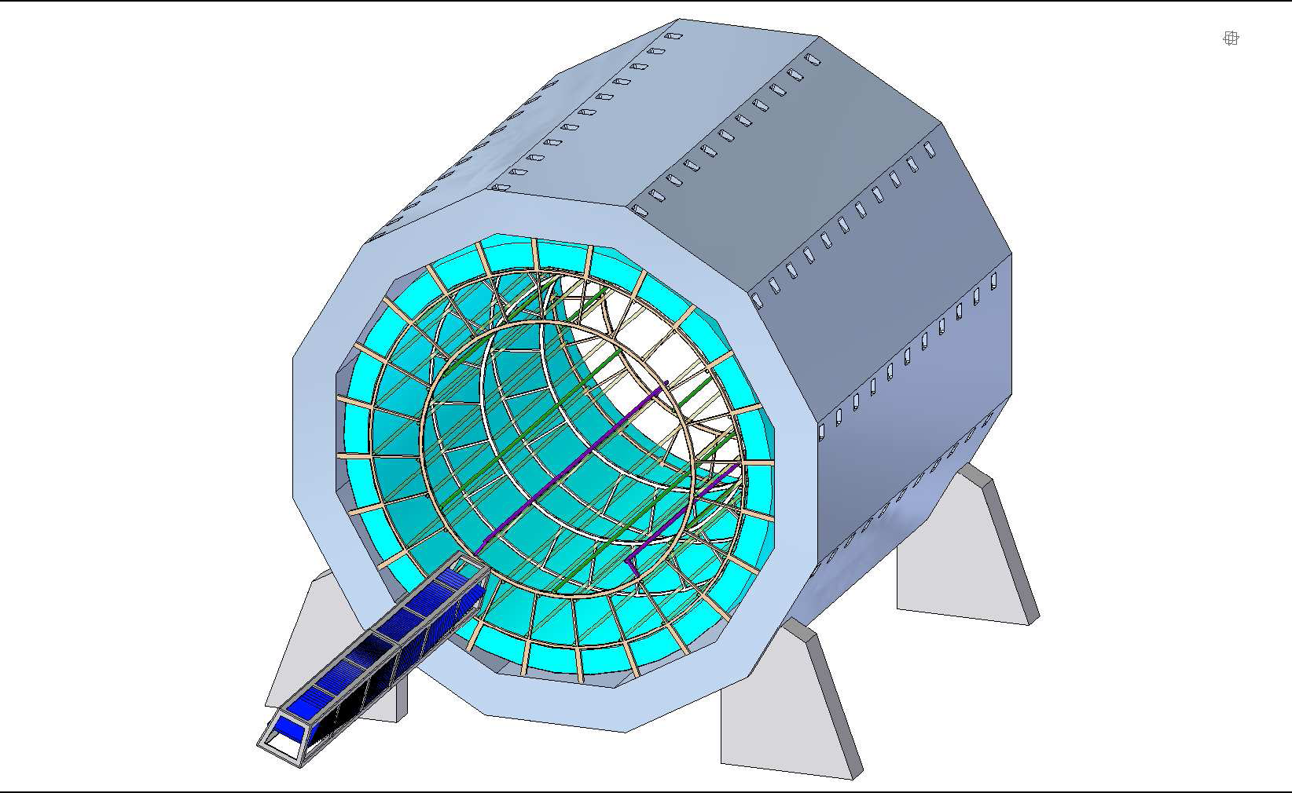
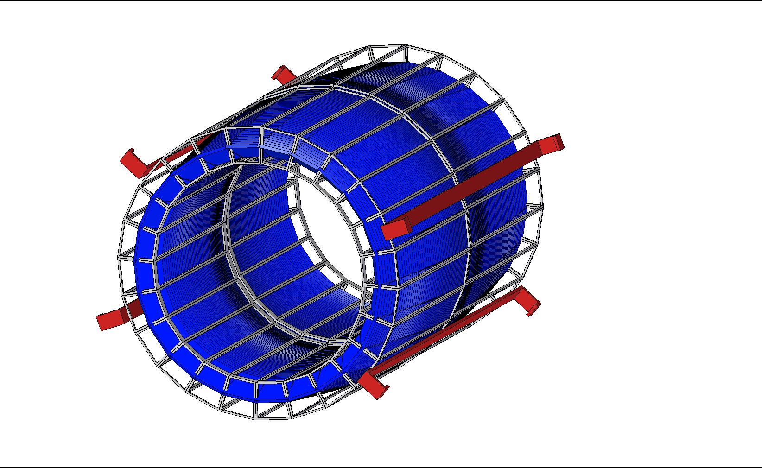
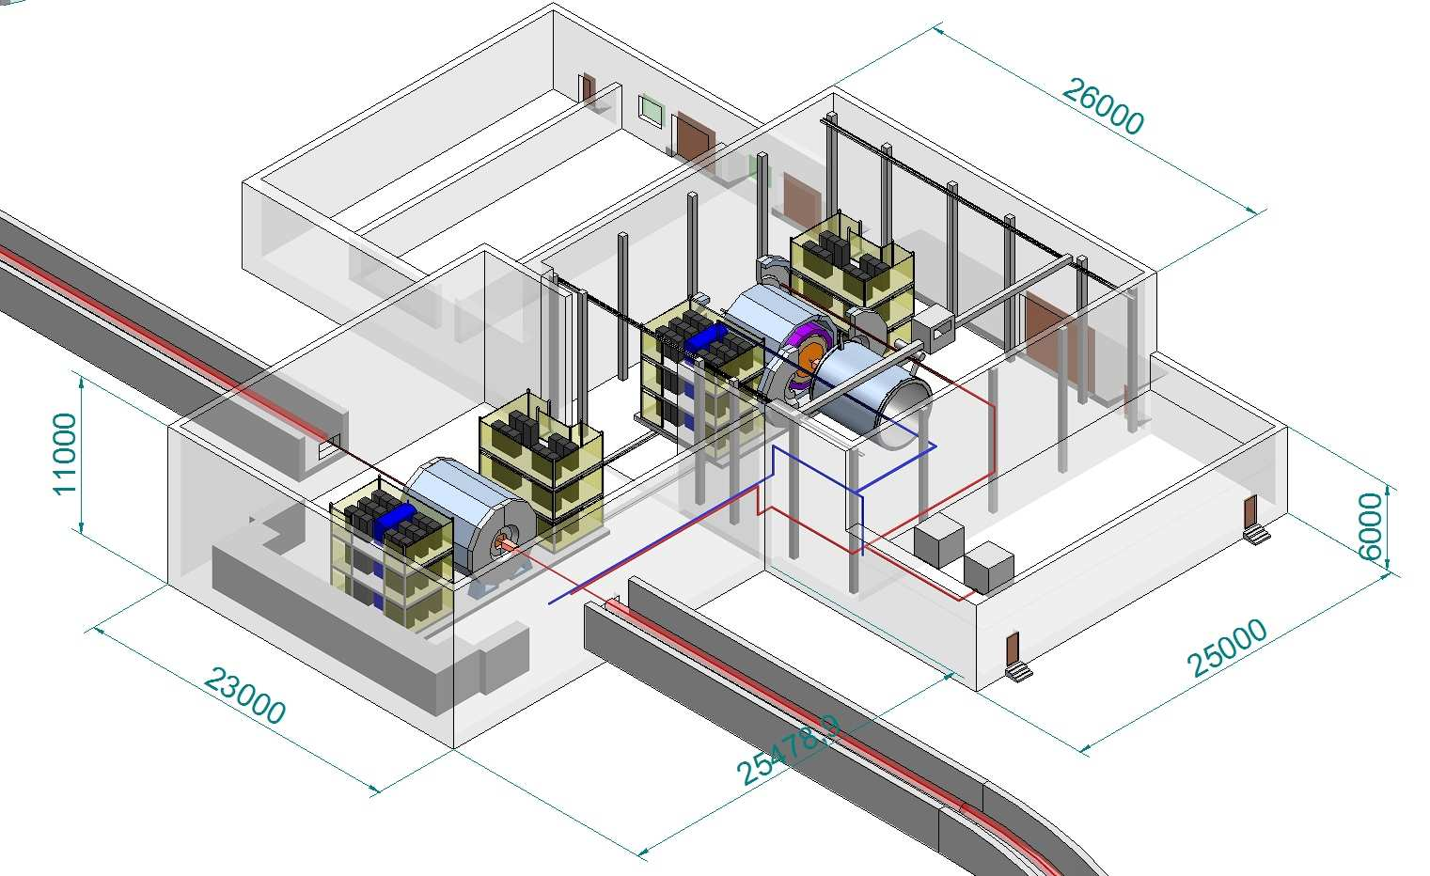
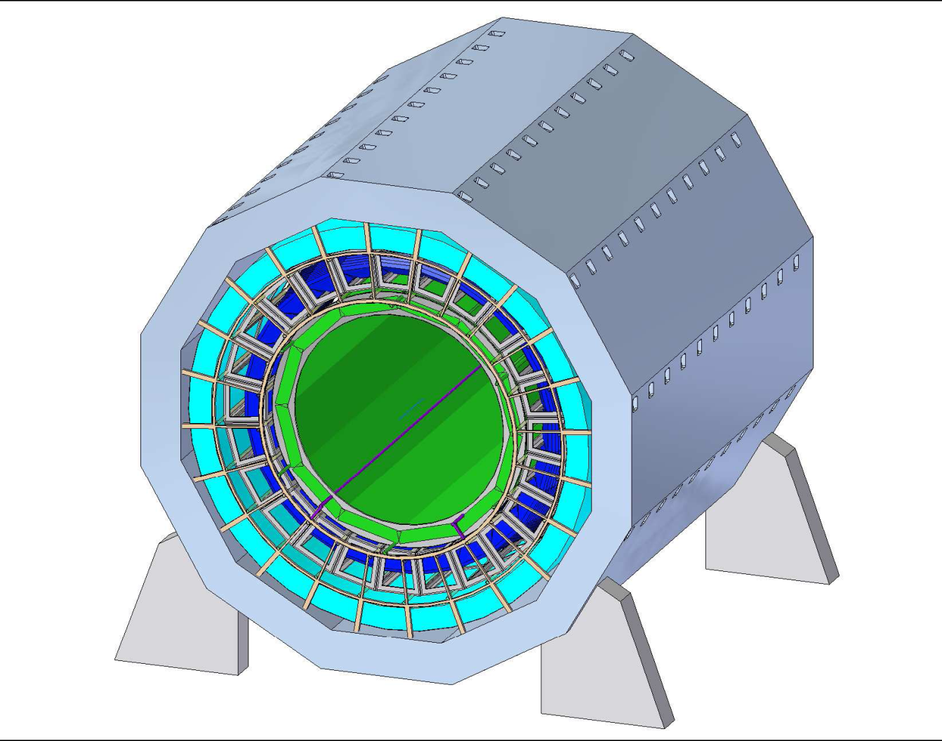
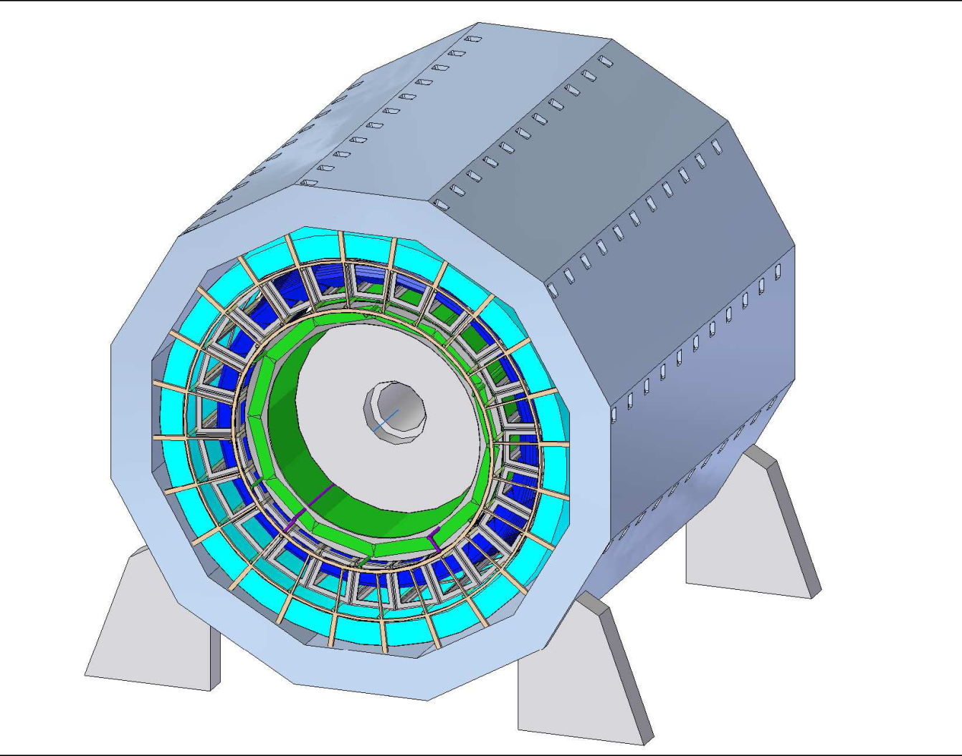
Assembly and maintenance
Solenoid + ECal
1
2
ECal
Solenoid
+ ECal
+TOF
Solenoid
+ ECal
+TOF
+TPC
3
4

Slide 15
V. Recommandations concerning the first meeting
of the MPD-Advisory Committee (DAC)
H. Gutbrod
The PAC supports this initiative … for detailed evaluation of the project realization, including critical assessment of the physics programme, design of the experimental set-up and recent developments in detector simulation.
The recommendations of the MPD-DAC taken at its meeting are presented in Addendum.
The PAC endorses these recommendations and looks forward to regular presentations of the DAC’s reports at its future meetings

Slide 16
Report of the NICA Detector Advisory Committee (DAC) to the 36th meeting of the PAC for Particle Physics on January 23-24th, 2012
J. Cleymans, H.H. Gutbrod, Nu Xu, L. Riccati, E. T-G, I.Tserruya
EVO meeting on January 17, with presentations from
V. Kolesnikov and S. Golovatyuk
Topics:
    Staging of the project
    b) Coverage of Phase Space by the proposed design
    c) Event Plane measurement
    d) Particle Identification
    e) Di-Leptons
    f) Event Generators
    g) Project management and International collaboration

Slide 17
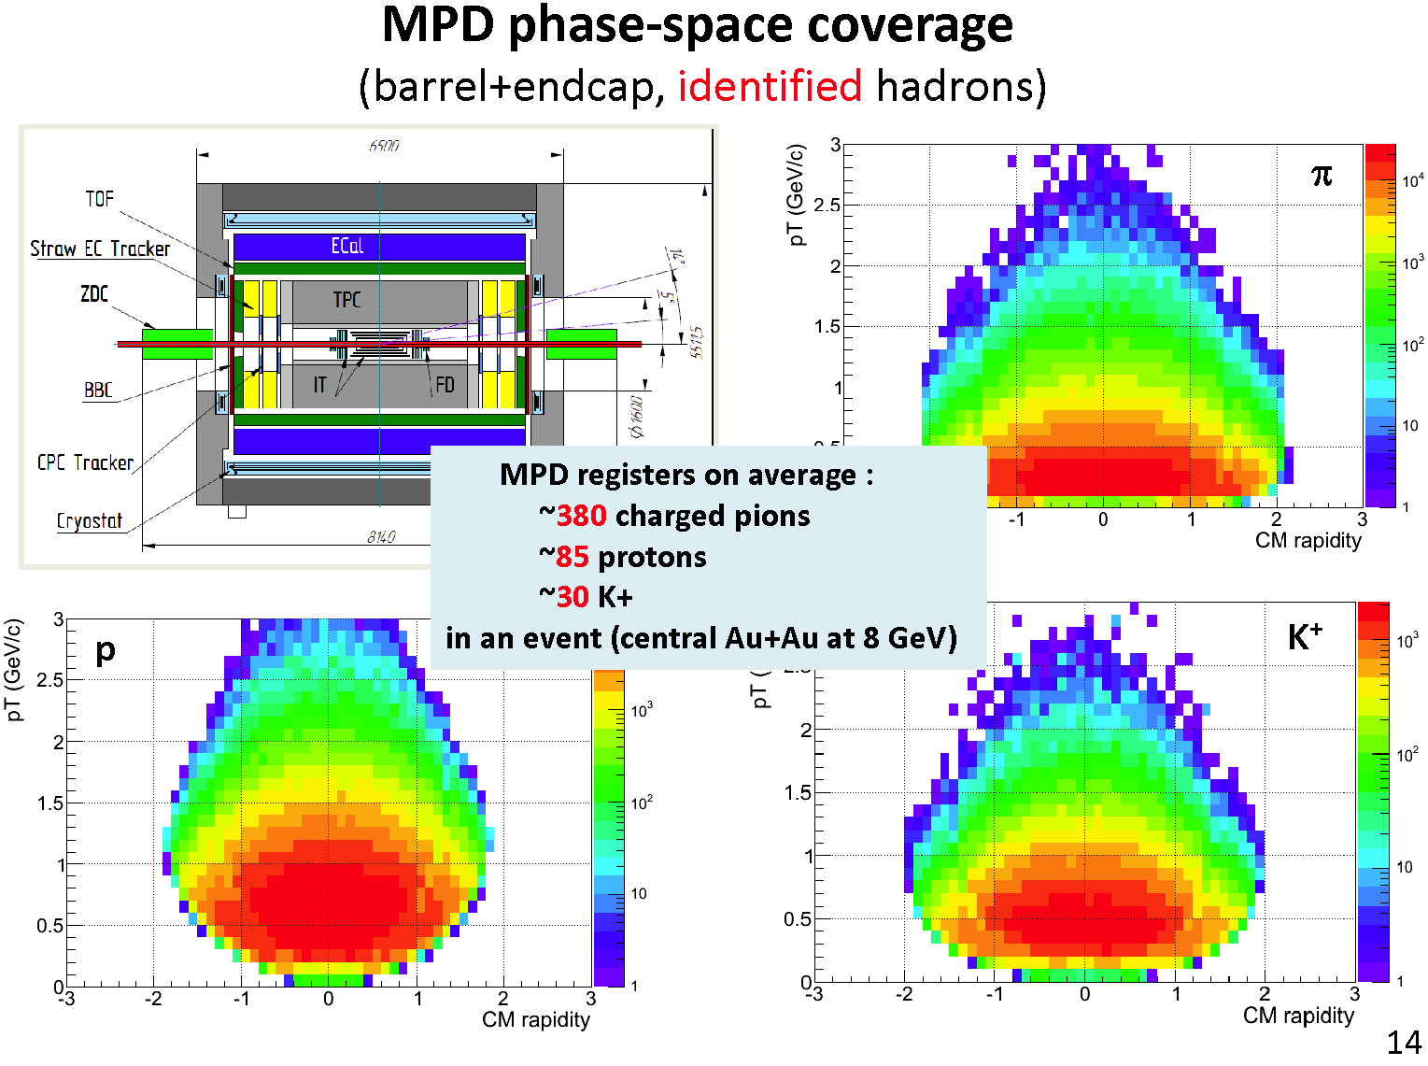
Make simulations also for low energy of 2 GEV

Slide 18
Report of the NICA Detector Advisory Committee (DAC) to the 36th meeting of the PAC for Particle Physics
H. Gutbrod
Conclusion and outlook
The work presented for MPD is quite impressive, and the MPD AC applauds the team working on that design.
MPD is pragmatically based on existing technology. With expected luminosities of few 10²⁷, there should be no problem in the feasibility
The MPD design is a very good one for a higher energy physics but needs serious tuning and modifications to be adequate for the low energy particles dominating the collisions.
If Staging is needed, a close to full coverage of 4π is recommended for the first stage in order to be competitive or superior to the existing programs at SPS and RHIC.
Simulations need to be ahead of technological choices or realisations and must be pursued vigorously.
The MPD-AC encourages the MPD team to form a project management and to include young promising scientist in positions of sub-projects leaders. The MPD-AC encourages the present MPD team leaders to look for international partners.

Slide 19
VI. Recommendations on the proposal for the SPD experiment at NICA
A. Nagaytsev
Polarized beams at the NICA accelerator facility to study nucleon spin structure. The PAC looks forward to the presentation of a detailed proposal.
A large part of the community interested in spin physics will gather in Dubna for the SPIN 2012 Conference. The PAC regards this as a unique opportunity to inform the international community, to attract new collaborations and to consolidate the SPD physics programme.

Slide 20

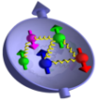
SPD EXPERIMENT AT NICA
A. Nagaytsev
The project on NICA Spin studies is under preparation at 2nd interaction point of the collider.
(first version of CDR for SPD , June 2010, http://nica.jinr.ru/files/Spin_program/spd_cdr.htm )
The purpose of proposed measurements is the study of the nucleon spin structure with high intensity polarized light nuclear beams.
high collision proton (deuteron) energy up to √s ~ 26(12) GeV
the average luminosity up to 10³¹-10³² cm²/s
both proton and deuteron beams can be effectively polarized.
THE SPIN PHYSICS DETECTOR- SPD
to study spin structure of the nucleon and polarization effects at NICA
(Conceptual Design Report)
The main topics are:
1. Studies of MMT-DY processes with longitudinally and transversely polarized p and D beams. Extraction of unknown (poor known) parton distribution functions (PDFs).
2. PDFs from J/Ψ production processes.
3. Cross sections, helicity amplitudes and double spin asymmetries (Krisch effect) in elastic reactions.
4. Spin effects in one and two hadron production processes.
5.Spin effects in inclusive high-p_{T} reactions.
6. Polarization effects in heavy ion collisions (with MPD).
7. Spectroscopy of quarkonia with any available decay modes.
JINR Dubna 2010
NICA Spin program plans:
2012-2014 – CDR and TRD preparation, SPD collaboration, R&D
2015-2018 – R&D, Detectors production
Notes:
20
20

Slide 21
Recommendations for new projects
Baryonic Matter at the Nuclotron (BM@N)
(P. Senger, V. Ladygin) : heavy ion collisions with Nuclotron extracted beams
The PAC considers this project, developed in collaboration with GSI, to be very important for its physics potential and for the development of associated instrumentation, in particular in view of application to the MPD detector.
The PAC …recommends approval of this project with first priority for one year until the end of 2012 under theme
02-0-1065-2007/2014 with the goal of preparing a comprehensive TDR.

Slide 22
Recommendations for new projects
Baryonic Matter at the Nuclotron (BM@N)
(P. Senger, V. Ladygin) : heavy ion collisions with Nuclotron extracted beams
The PAC considers this project, developed in collaboration with GSI, to be very important for its physics potential and for the development of associated instrumentation, in particular in view of application to the MPD detector.
The PAC …recommends approval of this project with first priority for one year until the end of 2012 under theme
02-0-1065-2007/2014 with the goal of preparing a comprehensive TDR.

Slide 23
V. Recommendations on the JINR contributions to LHC experiments
CMS, ATLAS, and ALICE experiments presented by S. Shmatov, A. Cheplakov, and M. Vodopianov. The PAC:
Emphasizes the scientific significance of the results being obtained with the active participation of JINR physicists
Encourages the groups to strengthen their efforts in the data analysis and in the presentation of the results at international conferences.
Looks forward detailed projects on the detector upgrades under the general guidance of the JINR Directorate .
Priorities and availability of resources

Slide 24
VII. Scientific reports
The PAC notes with interest the reports
“DANSS detector. Reactor neutrino problems” presented by A. Olshevskiy
and
“Recent results from the STAR Beam Energy Scan (BES) programme at RHIC”
presented by Nu Xu,
and thanks the speakers.

Slide 25
VIII. List of Posters DLNP-LIT-VBLHEP (I)
I. Alexandrov. Resource manager of the ATLAS Trigger and Data Acquisition system
2. E. Alexandrov. HEPWEB - WEB Page for Monte Carlo Simulations in High Energy Physics
3. P. Bunin. Hcal Endcap Intercalibration with Muons (pp-collisions)
4. D. Dedovich. Is there any LSND anomaly?
5. S. Dmitrievsky. Neutrino velocity measurement in the OPERA experiment
6. I.A. Filozova. JINR document server - Open Access repository of the Joint Institute for Nuclear Research: current status and perspectives.

Slide 26
VIII. List of Posters DLNP-LIT-VBLHEP (II)
7. A. Galimov. Cryogenic test of superconducting magnets for the NICA project
8. M.Gonchar. DayaBay experiment
9.I.Gorbunov. Measurements of Muon Forward-Backward Asymmetry in Drell-Yan
10.A. Petrosyan. Tier 3 Monitoring Software Suit (T3MON)
11.D. Korablev. Borexino Experiment in 2011
12.N.A. Kutovskiy. Distributed Training and Testing GridInfrastructure for JINR Member States
13.O. Samoylov. Precise measurement of charm dimuon production cross-section in neutrino-nucleon interactions and its various applications (NOMAD)
14.A.V. Yakovlev. The technology of integration online-services of the ATLAS LHC experiment and services of Grid-infrastructure

Slide 27
VIII. Poster presentations by young scientists in the field of particle physics research
The PAC notes with interest the poster presentations in particle physics presented by young scientists from DLNP, LIT and VBLHEP. It selected the poster “Precise measurement of charm dimuon production cross-section in neutrino-nucleon interactions and its various applications” presented by O. Samoylov to be reported at the Scientific Council session.

Slide 28
IX. Agenda (next meeting june 25-26)
Consideration of new projects (including NA61/NA49) and themes
Reports and recommendations on the projects to be completed in 2012
Report on progress towards the NICA White Paper
Status report on the Nuclotron-NICA and MPD projects
Report from the Nuclotron Run Coordinator
Reports on the scientific results obtained by the JINR groups in the LHC experiments and plans for their future upgrades.

Slide 29
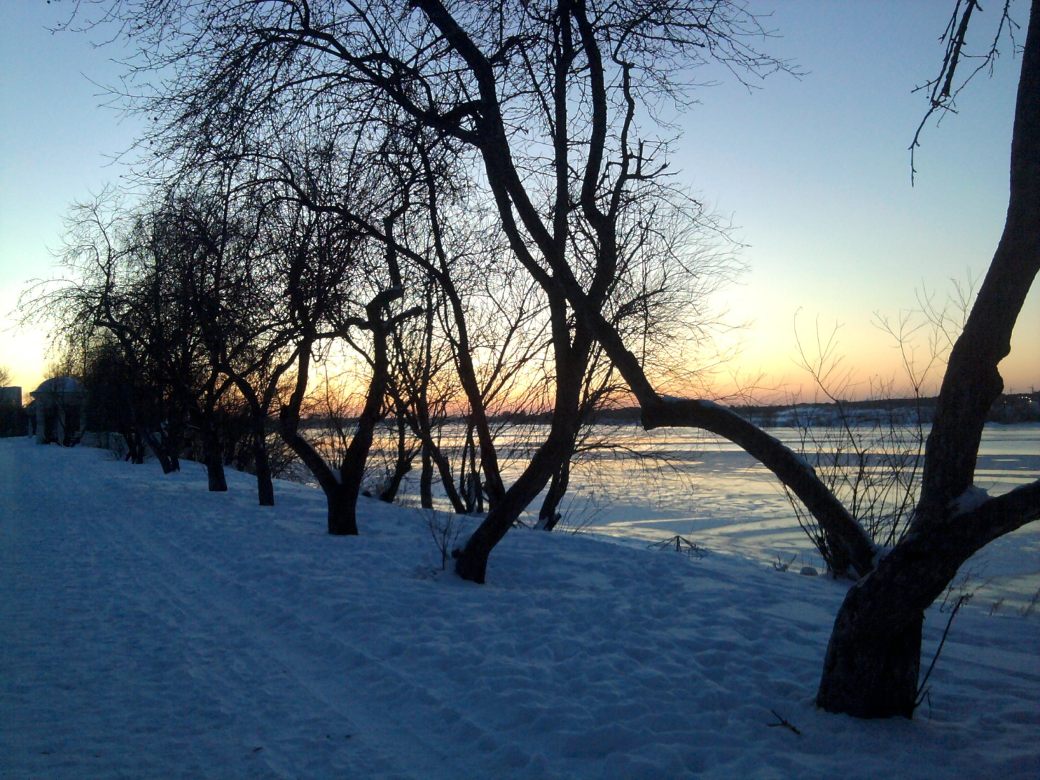
Thank you for attention
Благодарю вас за внимание

Slide 30
Round Table Discussions on NICA@JINR
Round Table Discussion I: Searching for the mixed phase of strongly interacting matter at the JINR Nuclotron, July 7 - 9, 2005 http://theor.jinr.ru/meetings/2005/roundtable/
Round Table Discussion II: Searching for the mixed phase of strongly interacting matter at the JINR Nuclotron: Nuclotron facility development JINR, Dubna, October 6 - 7, 2006
http://theor.jinr.ru/meetings/2006/roundtable/
Round Table Discussion III: Searching for the mixed phase of strongly interacting QCD matter at the NICA: Physics at NICA JINR (Dubna), November 5 - 6, 2008, http://theor.jinr.ru/meetings/2008/roundtable/
Round Table Discussion IV: Searching for the mixed phase
of strongly interacting QCD matter at the NICA: Physics at
NICA (White Paper)‏ JINR (Dubna), September 9 - 12, 2009
http://theor.jinr.ru/meetings/2009/roundtable/
Round Table Discussion V: Searching for the mixed phase of strongly interacting QCD matter at the NICA: Physics at NICA (White Paper)‏ JINR (Dubna), August 28, 2010 http://theor.jinr.ru/~cpod/Dubna_2010_program2.htm

Slide 31
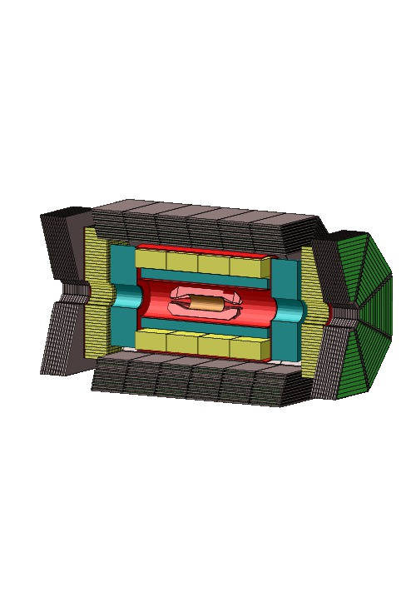
SPD EXPERIMENT AT NICA.
Proposal on SPD.
A. Nagaytsev
Proposed scheme of the SPD:
Toroid magnet system (TM)
Silicon detectors (VC)
Drift chambers (DC)
EM Calorimeter (EMC)
Range System (RS)
Trigger System (TS)
EndCap detectors with RS,
tracking system and EMC
SPD sizes: ~ 6.8 m along beams
~ 3.7 m in diameter
EMC
VC
RS
TM
TS
DC
Notes:
31
31

