Slide 1
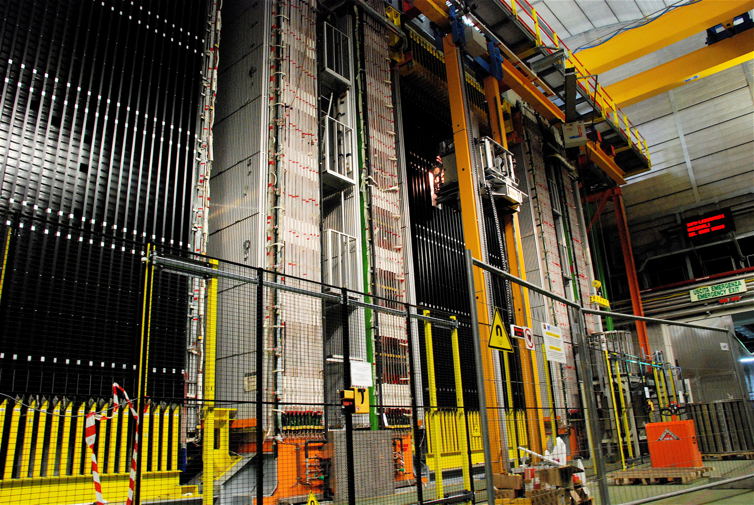

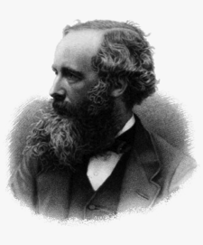
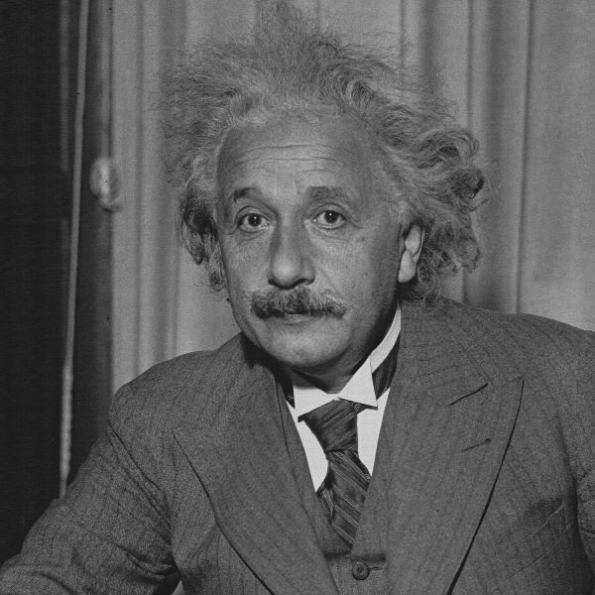
Versus and
Do neutrinos really travel faster than light?

Slide 2
History in the Making?
1862: Maxwell found that there should be electromagnetic waves travelling at approximately the (known) speed of light
1905: Einstein used universal speed of light as foundation of geometric description of physics
2011: OPERA finds 6-σ discrepancy between neutrino speed and that of light
“Life in the fast lane”

Slide 3
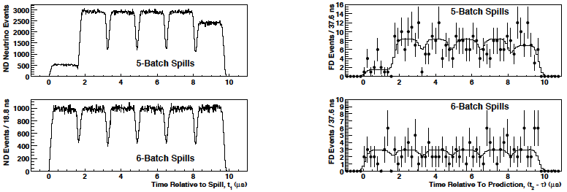
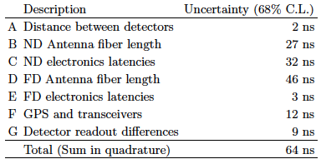
MINOS Measurement of ν Speed
Near & far detectors
Uncertainties
Published result
almost 2 σ > 0

Slide 4
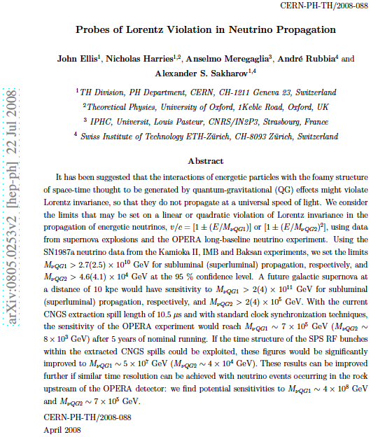

Slide 5
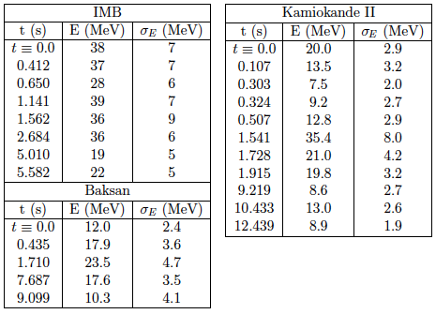
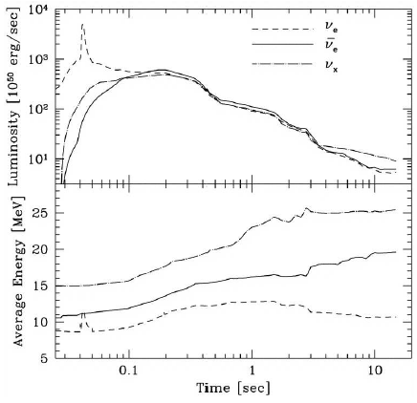
Constraints from Supernova 1987a
Data from 3 experiments
Arrived hours before γ’s
➔ δv < 10⁻⁹
Supernova simulation
Possible E dependence of δv constrained by bunching
JE, Harries, Mersegaglia, Rubbia & Sakharov: arXiv: 0805. 0253

Slide 6
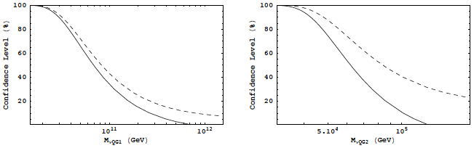
Constraints from SN1987a
Fit to possible E-dependent time-lag
Subluminal and superluminal cases
  Linear:
  Quadratic:
JE, Harries, Mersegaglia, Rubbia & Sakharov: arXiv: 0805. 0253

Slide 7
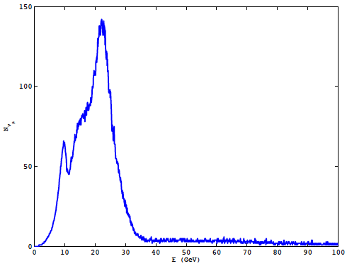
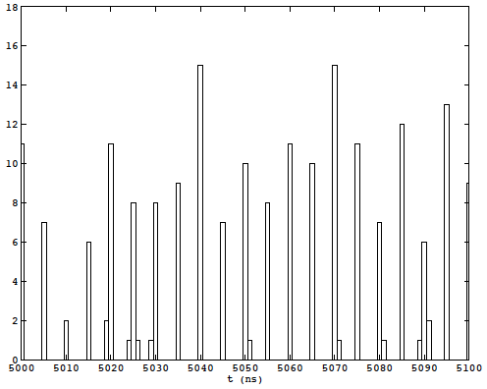
Structure of CNGS Beam
Energy Spectrum
Time structure
JE, Harries, Mersegaglia, Rubbia & Sakharov: arXiv: 0805. 0253

Slide 8
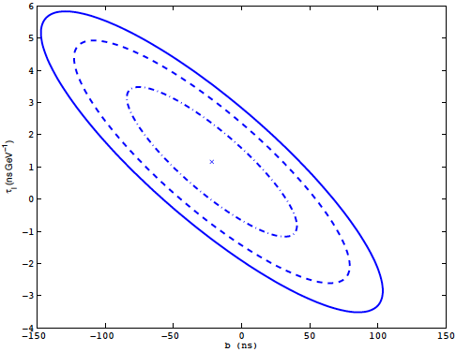
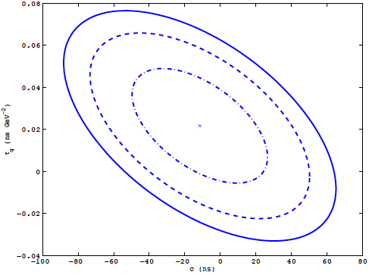

Fits to Simulated OPERA Data
Linear case
Sensitivity
Quadratic case
Sensitivity
JE, Harries, Mersegaglia, Rubbia & Sakharov: arXiv: 0805. 0253

Slide 9
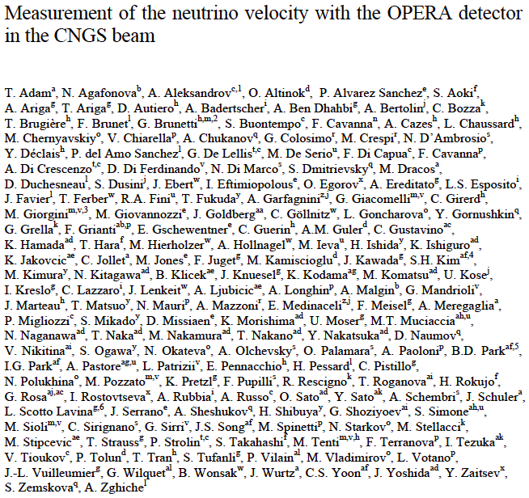

Slide 10
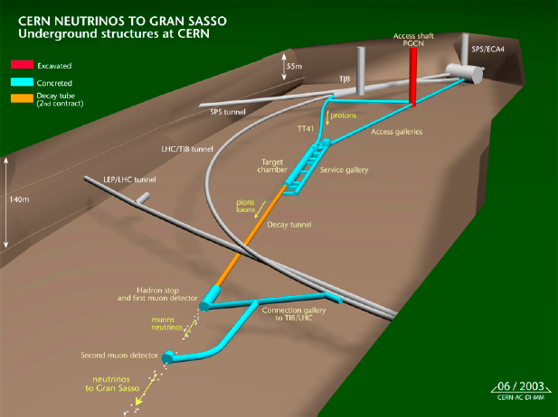
CNGS Beam
Layout at CERN

Slide 11
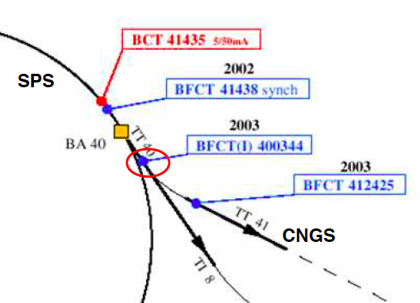
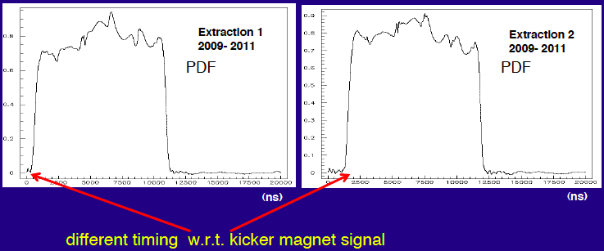
Time Structure of Proton Beam
As measured by
Beam Current Transformers
(BCTs)

Slide 12
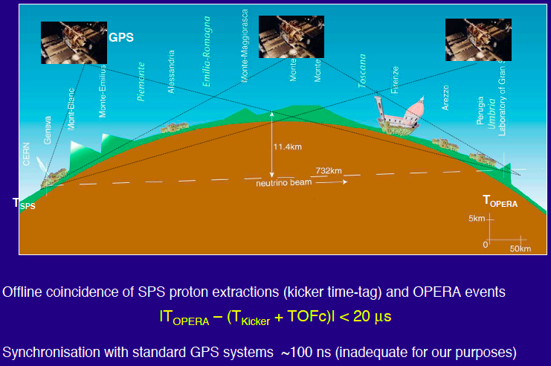
Timing using the GPS System

Slide 13
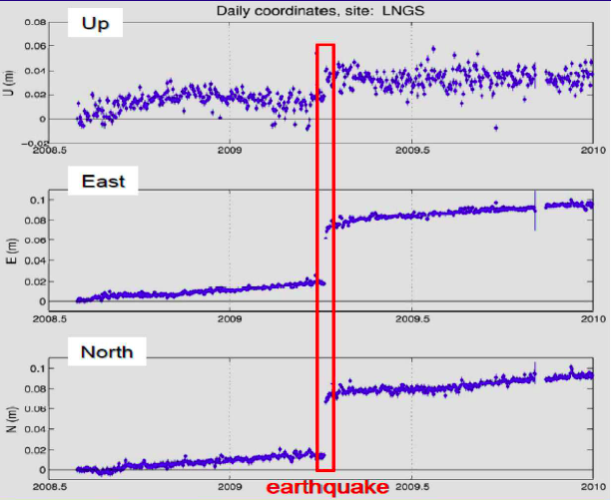
Continuous Distance Monitoring
Clear effect of
continental drift,
also clear signature
of L’Aquila earthquake
(movement ~ 7 cm)

Slide 14
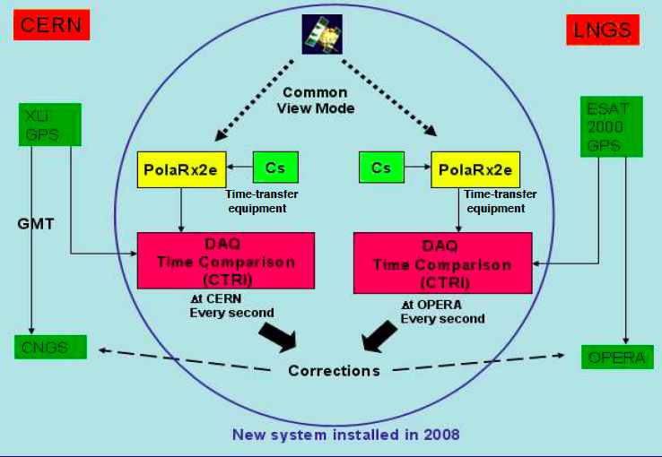
Summary of Synchronization Procedure

Slide 15
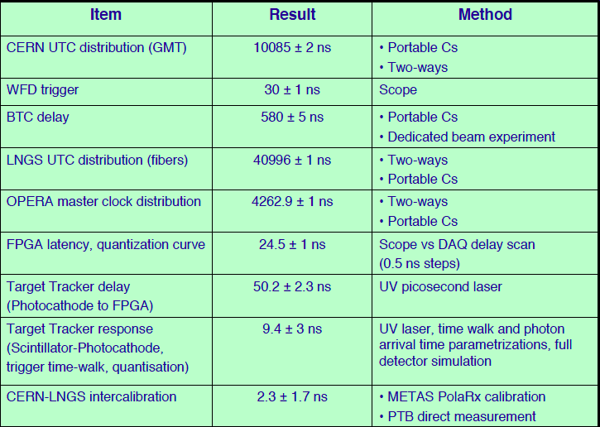
Summary of Timing Uncertainties

Slide 16
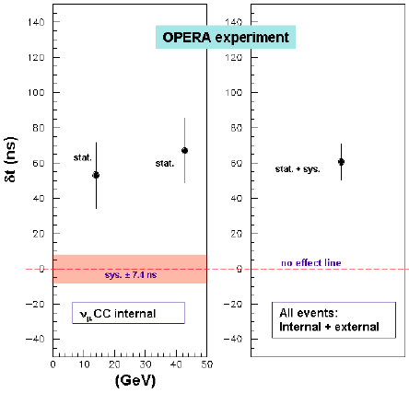
The Main Result

Slide 17
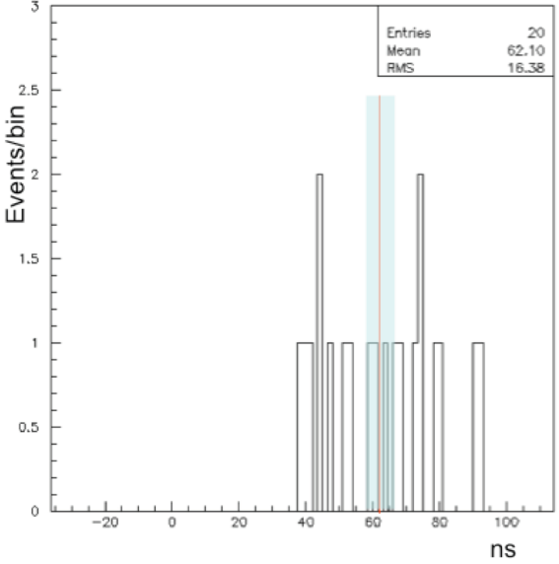
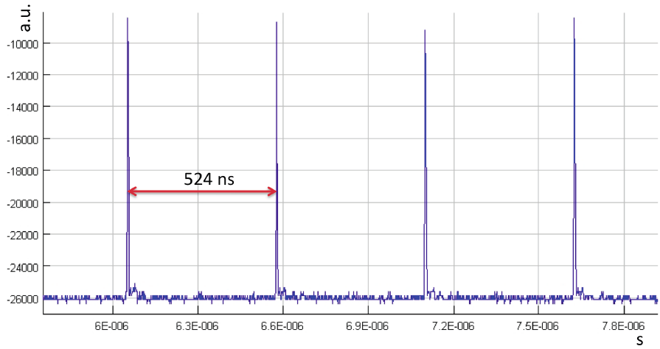
Test with Bunched Beam
Avoid problem of modelling spill by using bunched beam:
Reproduce same timing advance

Slide 18


Special and General Relativity
Sagnac effect (rotation of Earth during travel):
: δt = + 2.16 ns
Tends to increase travel time
Smaller than total error, taken into account
Schwartzschild effects ~
  Neutrinos follow geodesic, re-evaluate Euclidean distance
Non-inertial effects, redshifts of clocks, dipole field, frame-dragging all negligible
Kiritsis & Nitti: OPERA public note 136

Slide 19
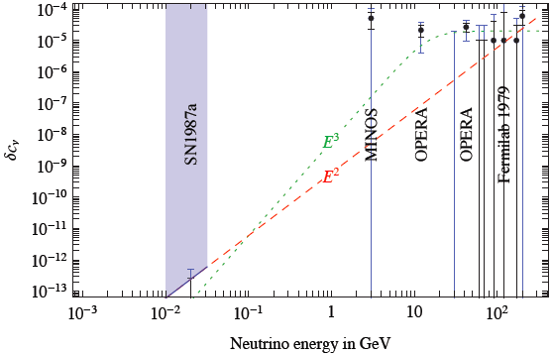
Comparison of Neutrino Constraints
Cacciapaglia, Deandrea & Panizzi: arXiv: 1109. 4980
Giudice, Sibiryakov & Strumia: arXiv: 1109. 5682
SN1987a excludes δv ~ E or E²
Alexandre, JE & Mavromatos: arXiv: 1109.6296

Slide 20
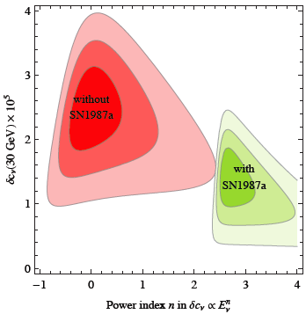
Power-Law
Fit to
Neutrino Data
Need δv ~ E^{n}
with n > 2.5
Giudice, Sibiryakov & Strumia: arXiv: 1109. 5682

Slide 21
Could Neutrinos be Tachyons?
v would approach c from above as E increases
No non-trivial finite-dimensional unitary representations of Lorentz group for m² < 0
  i.e., no spin-1/2 spinors
Should spin 0 be quantized as bosons?
  “No” (Feinberg) vs “Yes” (Sudarshan)
Problem of causality!
  Reinterpret backward emission of E < 0 as forward emission of E > 0?
Deform/break Lorentz symmetry?

Slide 22

Lifshitz-Type Field Theory
Time and space dimensions scale differently
  (Interesting for quantum gravity, mass generation)
Anisotropy parameter z
Model for neutrino velocity:
Action:
Dispersion relation:
Group velocity: v_{g} = > c
Superluminal propagation: δv ~ E²
J. Alexandre: arXiv: 1109.5629
Alexandre, JE & Mavromatos: arXiv: 1109.6296

Slide 23


Lorentz-Violating Gauge Theory
Background vector or axial U(1) gauge field:
Dispersion relation:
Group velocity:
Subluminal propagation
  (so far …)
Alexandre, JE & Mavromatos: arXiv: 1109.6296

Slide 24





Background Gauge Field
Allow background gauge field:
Disersion relations:
  (ν ≠ anti-ν)
Subluminal group v:
Include anisotropic background:
Group velocity may be super- or subluminal:
Dependent on direction!
Alexandre, JE & Mavromatos: arXiv: 1109.6296

Slide 25
Suggests Exotic Possibilities
Neutrino speed ≠ antineutrino speed?
Speed depends on direction?
Possibility of diurnal variation as Earth rotates
If no diurnal variation, V aligned with Earth’s rotation axis
In this case:
  Neutrino going North (MINOS) subluminal
  Null effect for neutrinos travelling East-West (T2K)
Alexandre, JE & Mavromatos: arXiv: 1109.6296

Slide 26



Čerenkov Radiation by Neutrinos
Possible if speed > light
dominant process e⁺e⁻ Bremsstrahlung Energy loss rate:
Difference between initial/final energies, terminal energy E_{T}:
Sensitive to δ = 2 δv and its E dependence
Applied to IceCube data suggests
Does not apply to models with distorted metrics, nonlinear deformations of Lorentz symmetry
Cohen & Glashow: arXiv: 1109.6562

Slide 27
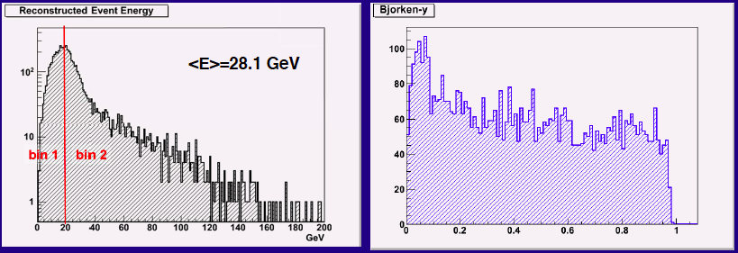
Distortion of Energy Spectrum?
Events seen up to very high energies >> <E_{ν}> = 28.1 GeV
No apparent distortion of kinematic observables
(relevant to possibility of Čerenkov radiation)

Slide 28
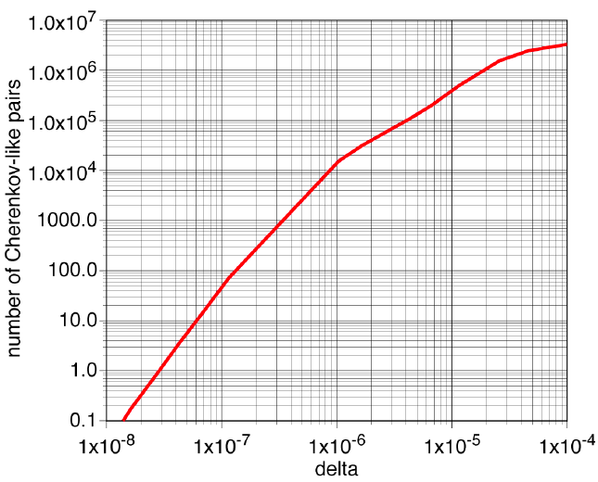
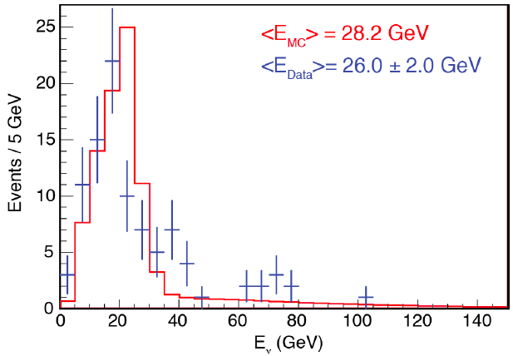
Constraints from ICARUS
No visible distortion of neutrino energy spectrum
No excess of e⁺e⁻ pairs
If δ ~ E², decay length > 20,000 km,
distortion not visible? …
Cohen & Glashow: arXiv: 1109.6562
… but expect ~ 10⁵ events in OPERA
ICARUS Collaboration: arXiv: 1110.3763
Mohanty & Rao: arXiv: 1112.2981

Slide 29
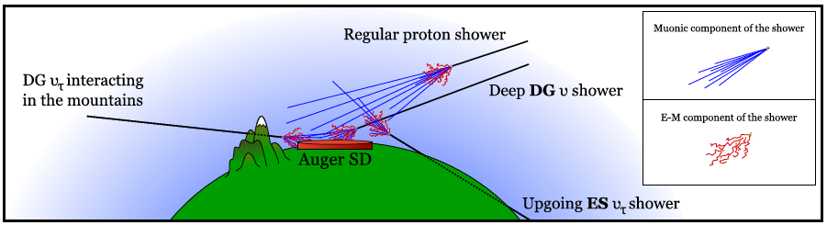
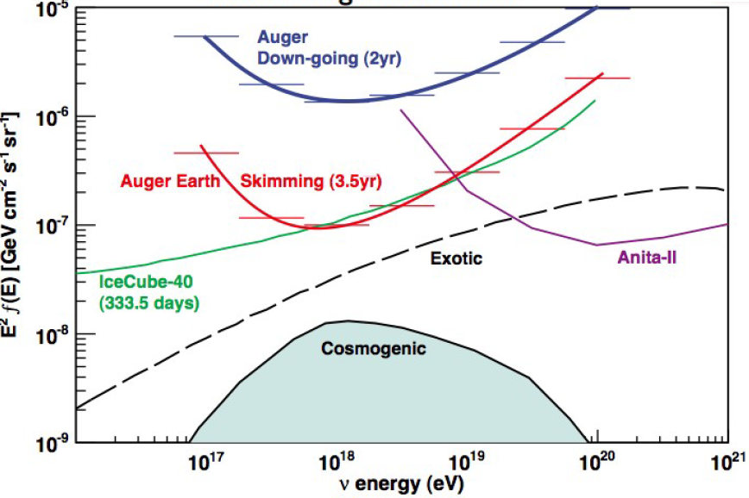
GZK Neutrinos?
  Ultra-high-energy cosmic rays: p + γ ➔Δ➔N + π➔ν
Search underway with Auger, IceCube et al
Flux uncertain,
other possible sources
Could also be affected by
Lorentz violation
Sensitive to δ ~ 10⁻²⁷

Slide 30

Gravitational Čerenkov Radiation
Possible if speed > gravity waves, assumed = c
Gravitational Čerenkov radiation: with OPERA
δv ~ 2.5 ✕ 10⁻⁵, maximum propagation time:
Excludes GZK neutrinos (E_{ν} ~ 10¹⁰ GeV, t ~ 10⁸ y) by many orders of magnitude
IceCube sees no neutrinos with E_{ν} > 2 ✕ 10⁶ GeV: would have t_{max} < 10⁻⁴ s
Alexandre, JE & Mavromatos: arXiv: 1109.6296

Slide 31
Experimental Checks
CNGS:
  2012 run with conventional beam, bunched beam, antineutrinos
OPERA:
  Fast muon detectors
  Independent timing (fibre, transfer atomic clock?)
Other Gran Sasso experiments
  ICARUS, Borexino, LVD (?)
MINOS:
  Re-evaluate old data, 2012 run, MINOS+

Slide 32
The Story so far
No technical error found
  OPERA carried out test with separated bunches
No theoretical error found
Difficult to reconcile with other constraints
  (SN1987a, Cohen-Glashow radiation, …)
No direct contradiction with other experiments
Other experiments are preparing to check
This is how science should be done
  (technical scrutiny, verification, tests, theory)

Slide 33
