Slide 1

First-Priority Tasks
of the JINR Directorate for the Nearest Years
V. Matveev
Acting Director of JINR
110th Session of the JINR Scientific Council
15–16 September 2011

Slide 2
CONTENTS
Introduction
State Prize of the Russian Federation in science and technology for 2010
Visit of the Russian Prime Minister V. Putin to Dubna/JINR. Session of the Government Commission on High Technology and Innovation
Basic principles of the JINR Directorate’s policy
Conclusion
V. Matveev – 110th session of SC

Slide 3

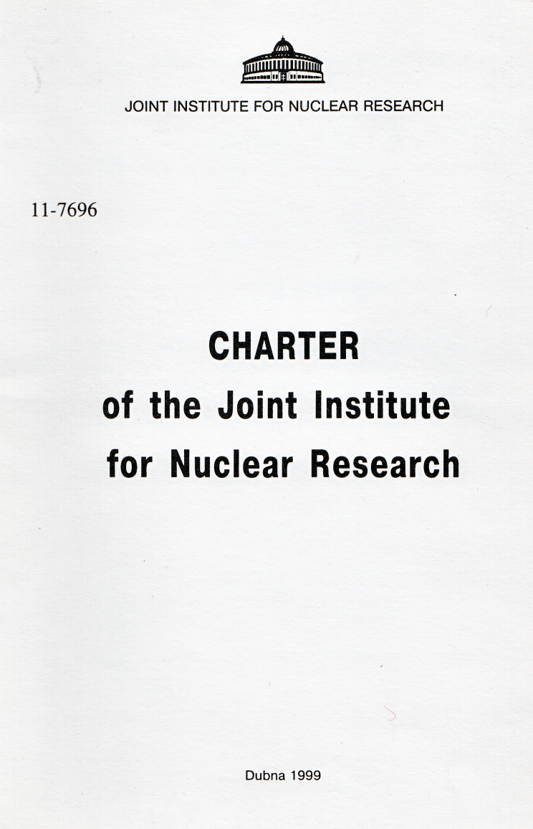
CHAPTER V
Directorate of the Institute
Article 24
The Director is elected by the Committee of Plenipotentiaries for a 5-year term and takes his office on the 1st of January of the year following his election.
V. Matveev – 110th session of SC

Slide 4


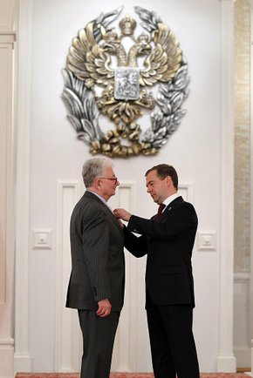
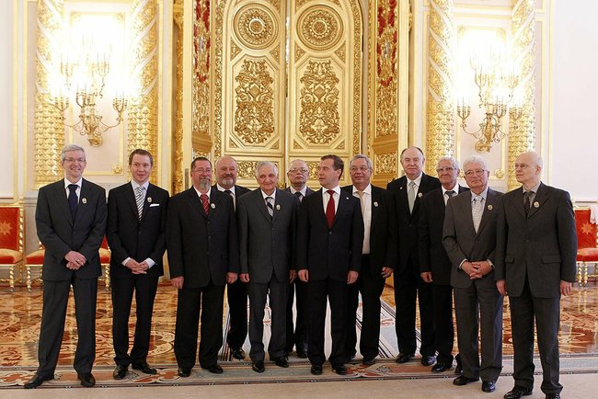
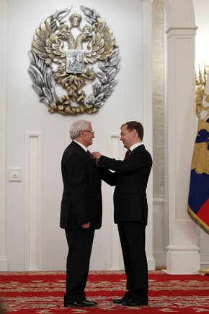
Academician Yu. Oganessian and Professor M. Itkis – laureates of the 2010 State Prize of the Russian Federation in science and technology
Academician Y.Oganessian
Moscow, Kremlin, 12 June 2011
The full text of the information is available at: http://news.kremlin.ru/ref_notes/961
V. Matveev – 110th session of SC

Slide 5
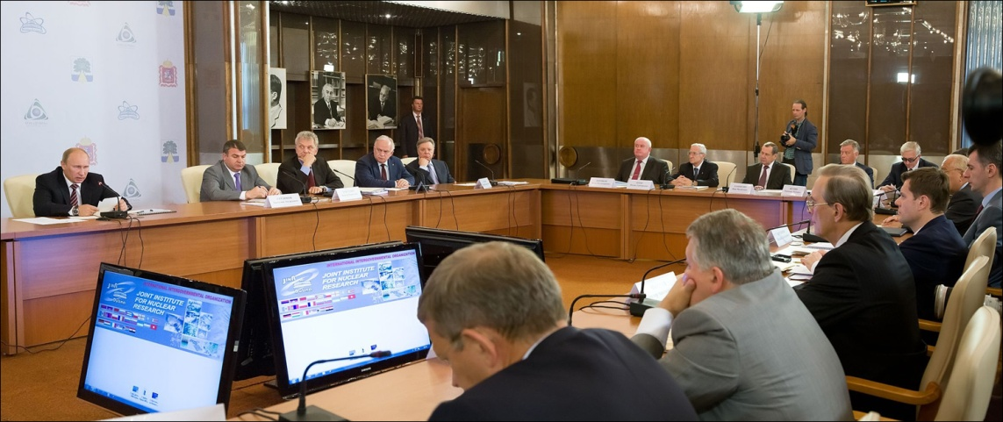
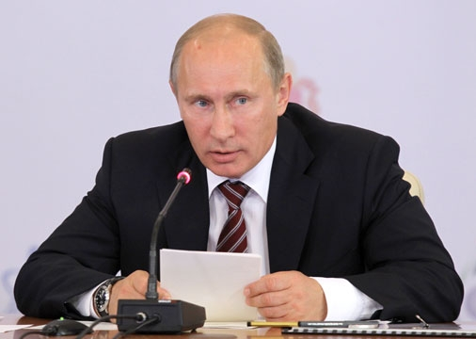
Prime Minister of the Russian Federation Vladimir Putin held a session of the Government Commission on High Technology and Innovation in Dubna
5 July 2011
“I believe there are all the necessary conditions to start building world-class research facilities in Russia, mega-class research installations that would be similar in size to the world-renowned Large Hadron Collider, in order to obtain results worthy of the Nobel prize.”
Vladimir Putin, at the session of the Government Commission on High Technology and Innovation in Dubna
V. Matveev – 110th session of SC

Slide 6
Session of the Government Commission on High Technology and Innovation in Dubna
Prior to the session, the Ministry of Education and Science of the Russian Federation, jointly with the interagency working group, selected 6 out of 28 submitted applications which meet the highest requirements imposed to specify the class of “mega-science” facilities. Among them is the NICA project.
The purpose of the meeting in Dubna was:
to develop criteria for final selection
to organize an international expertise and a broad
discussion in the scientific community,
to run a full cycle of preparatory work - from the
conclusion of international contracts with rigidly fixed
financial obligations of all participating countries, to the
selection of a management company.
Tokamak IGNITOR
High-flux research reactor, PIK
Synchrotron radiation source of IV generation, ISSI-4
Complex of superconducting rings with colliding beams of heavy ions, NICA
International research centre for extreme light fields based on sub-exawatt power laser complex
Accelerator complex with electron-positron colliding beams
V. Matveev – 110th session of SC

Slide 7
Joint Institute for Nuclear Research
Session of the Government Commission on High Technology and Innovation
5 July 2011, Dubna
Комплекс сверхпроводящих колец на встречных пучках тяжелых ионов NICA
(комплекс NICA)
Complex of superconducting rings with colliding beams of heavy ions NICA
(NICA facility)
V. Matveev
V. Matveev – 110th session of SC

Slide 8
JINR’s Achievements – a Basis for Advancement Towards New Objectives
Synthesis of new transfermium elements
Condensed
matter
studies
Particle and
nuclear
high-energy physics
Internationally recognized leadership:
- Discovery of the “Island of Stability”
102-104, 105 (Dubnium), 108, 113 – 118
Superheavy elements
Russian President Prize, 2011
- Experimental base for research:
(U400, U400М, DRIBs ),
with its further upgrade, will secure leadership for decades
Russian State Prize, 2010
World-class facilities:
- pulsed reactor IBR-2М
neutron resonance source IREN
International multi-access centre
Integrated into the European research infrastructure
Pioneering research on
neutrino physics and
relativistic nuclear physics
First in the word superconducting accelerator of heavy nuclei
Contributions to construction of large facilities for the LHC (CMS, ATLAS, ALICE)
Activities within broad international cooperation
Development of advanced techniques for particle acceleration and detection
Modern IT (GRID)
V. Matveev – 110th session of SC

Slide 9

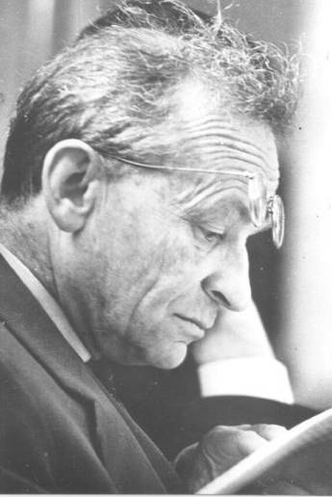
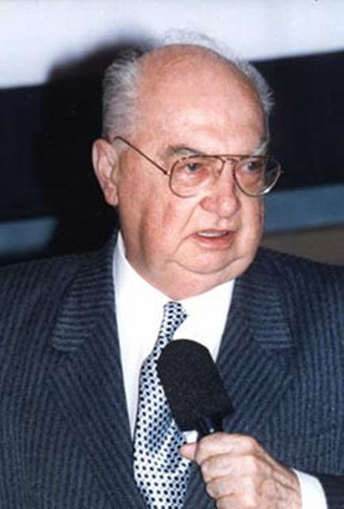
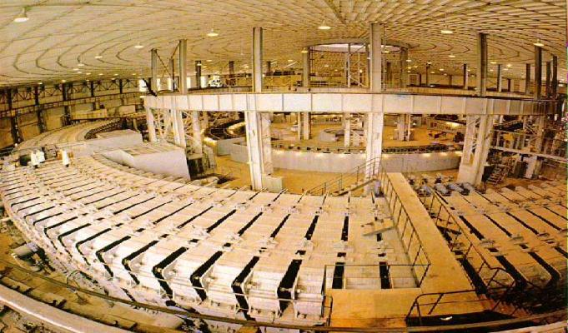
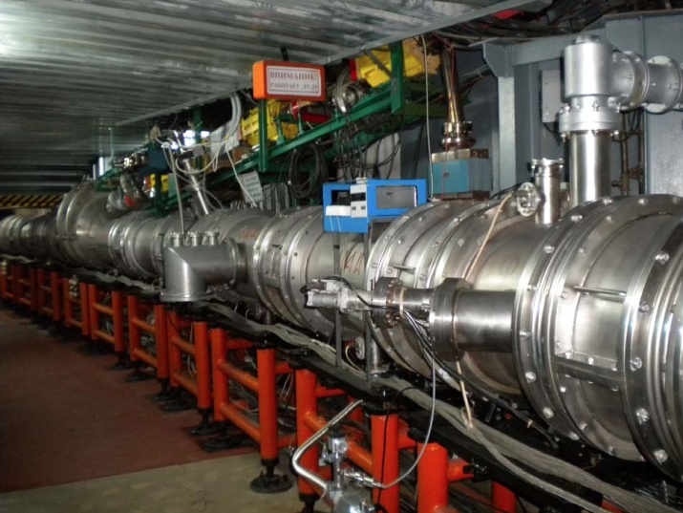
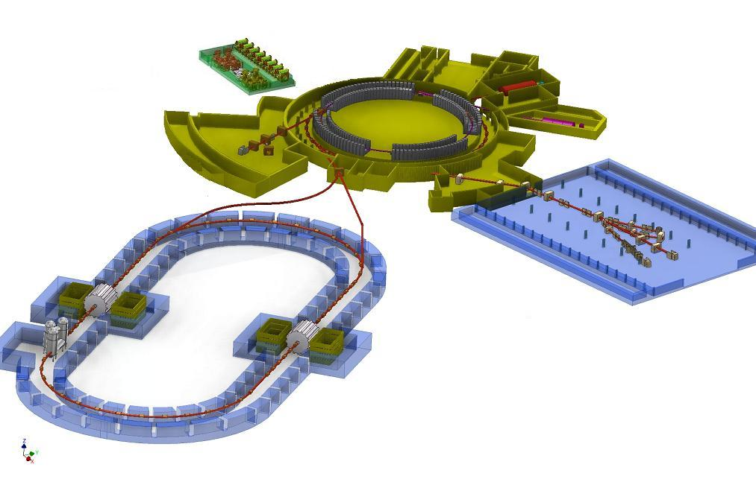
From the First Synchrotron to High-Energy
Heavy-Ion Physics
1957 Synchrophasotron
1993
Nuclotron
2017
NICA
10 GeV Aaccelerator of protons – world leader
in energy
Beginning
of the era of
high-energy
physics
First in the world
Superconducting synchrotron of
heavy ions
Superconducting collider of heavy ions
V. Veksler - discovery
of the phase stability
principle
A. Baldin - beginning
of relativistic nuclear physics
Study of nuclear
matter at maximum density
V. Matveev – 110th session of SC

Slide 10
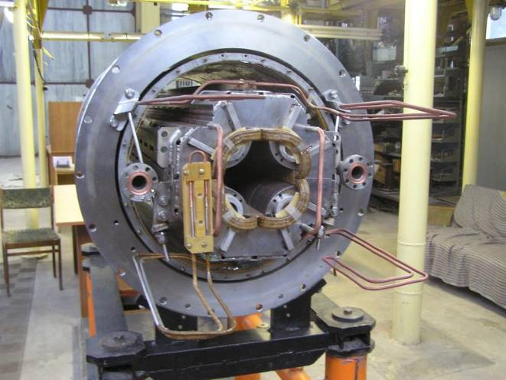
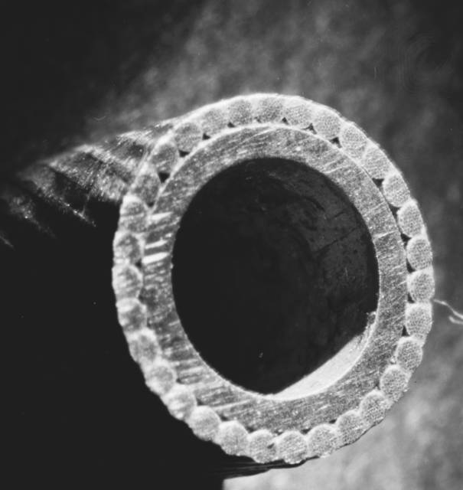
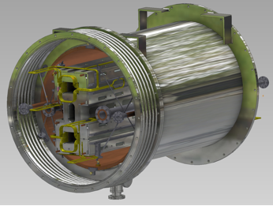
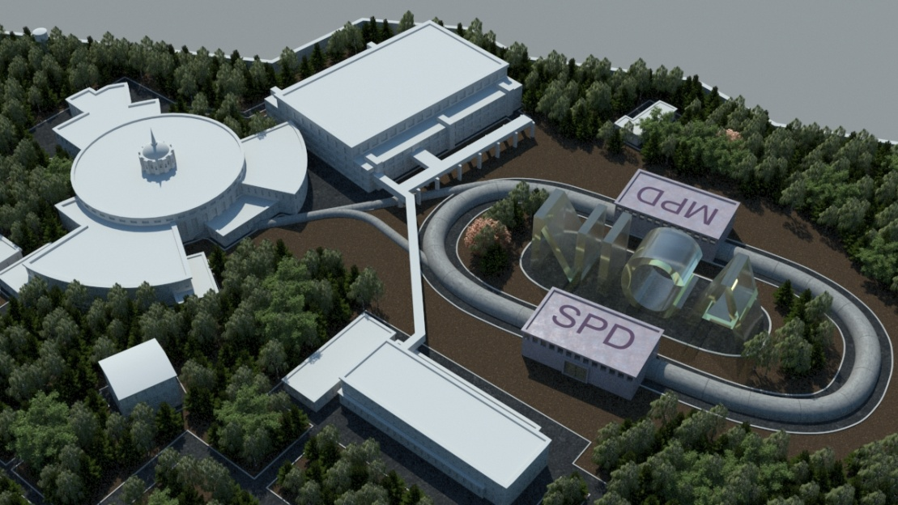
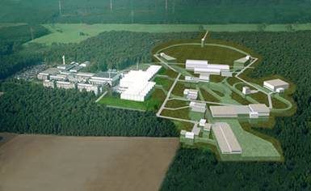
Russian Government Prize 2010
(jointly with ITEP)
Dubna’s unique technology for superconducting magnets, tested during the Nuclotron development and chosen as the basic one for new complexes of NICA (JINR, Russia) and FAIR (GSI, Germany)
NICA project (Dubna, Russia)
FAIR project (Darmstadt, Germany)
V. Matveev – 110th session of SC

Slide 11
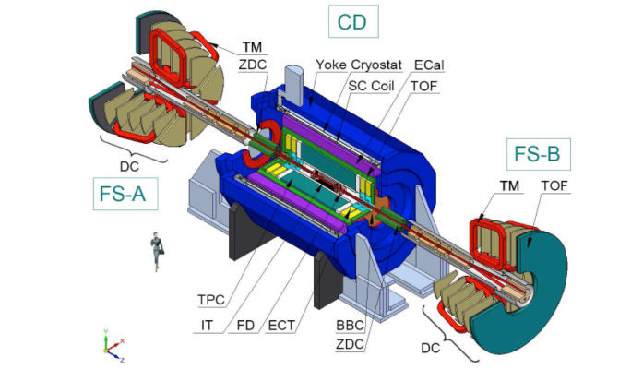
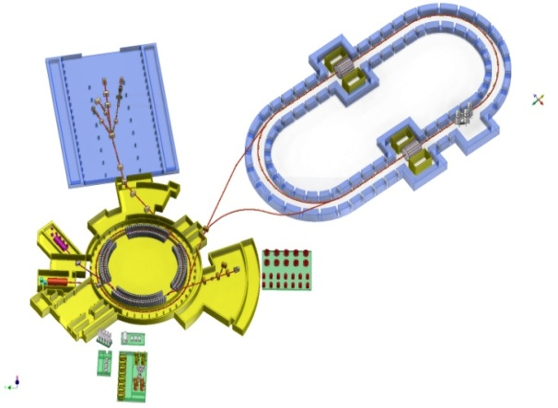
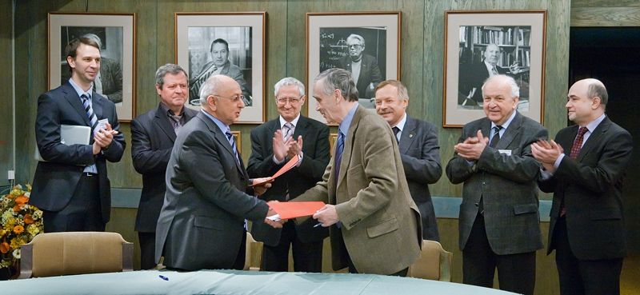
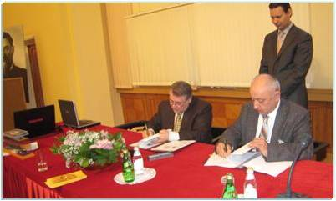
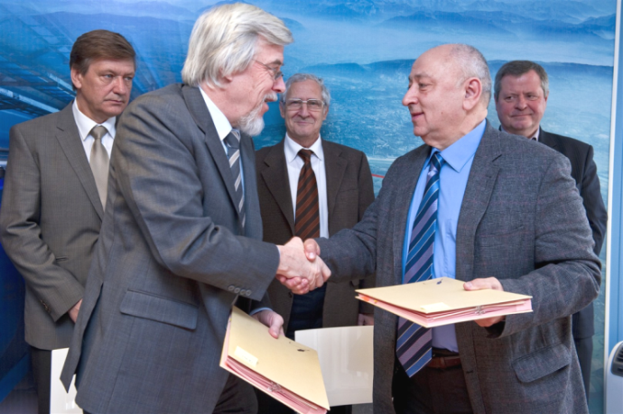
V.Yarba, V.Lebedev, S.Nagaitsev, A.Zlobin (FNAL), T.Roser, A.Fedotov (BNL)
INTERNATIONAL
EXPERTISE
OF THE PROJECT
B.Sharkov (FAIR), N.Walker (DESY), R.Stassen, Yu.Senichev (FZJ), M.Steck (GSI)
P.Zenkevich (ITEP), S.Ivanov (IHEP)
COLLIDER
DETECTOR
P.Belochitskii,
L.Thorndlall
(CERN)
T.Katayama
(Tokyo Univ)
Machine Advisory Committee (МАС)
for the Accelerator Complex
Programme Advisory Committee (РАС)
for Particle Physics
International Agreements on cooperation
JINR – INP SB RAS
JINR - CERN
JINR – RSC KI
V. Matveev – 110th session of SC

Slide 12
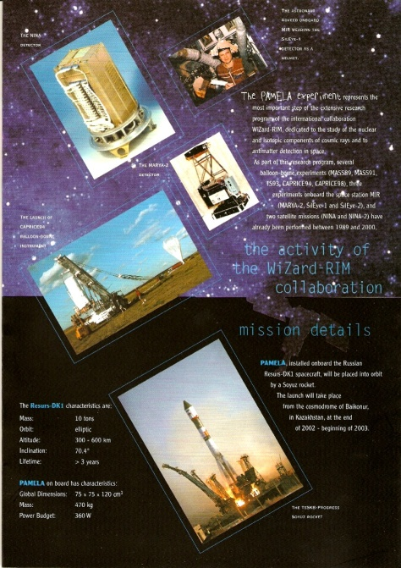
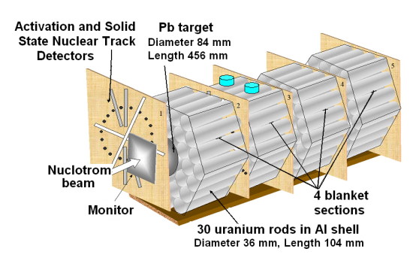
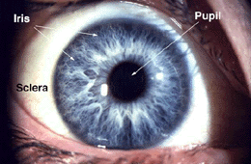
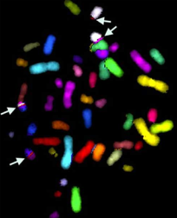
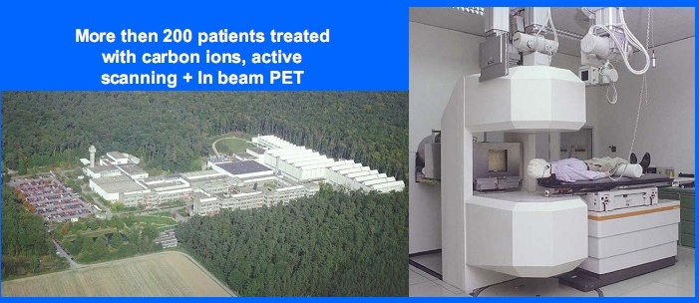
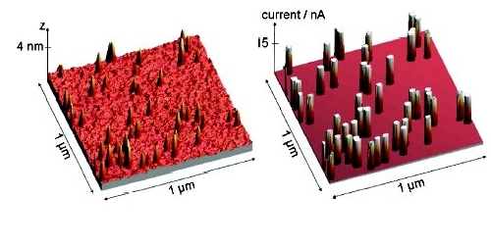
NICA-Based Innovative Projects
Nuclear waste transmutation
Radiobiology and Biomedicine
Ground-based tests of space equipment elements
Acquisition of nuclear-physics data to design a set-up for nuclear waste transmutation
Studies of molecular mechanisms of genetic effect on human cells and damage of visual functions
Development and application of accelerator and detector technologies
in medicine
Ion-track technology
Production of nanowires, nanomembranes, nanotransistors…
V. Matveev – 110th session of SC

Slide 13
Financing profile of the megaproject NICA (mln. roubles)
 | 2010 | 2011 | 2012 | 2013 | 2014 | 2015 | 2016 | Total
Accelerator block | 220 | 200 | 450 | 644 | 660 | 205 | 185 | 2564
Experimental block (Detectors) | 30 | 37 | 230 400 | 353 500 | 340 500 | 230 700 | 130 600 | 1350 2700
Applied research and innovations |  |  |  | 100 | 200 | 250 | 350 | 900
Infrastructure (scientific research and engineering) | 30 | 99 | 150 200 | 191 200 | 90 300 | 30 350 | 350 | 600 1400
Infrastructure (social) | 150 | 150 | 200 | 200 | 250 | 250 | 300 | 1500
TOTAL | 260 | 336 | 830 600 | 1188 800 | 1090 1000 | 465 1300 | 315 1300 | 6014 5000
The resources required are shown in red: 5000 mln. roubles
V. Matveev – 110th session of SC

Slide 14


Expected results
World leadership in relevant fields of fundamental research (phase transitions and critical phenomena in nuclear matter)
New knowledge about the Universe
Novel technologies and formation of modern high-tech environment
Intellectual Magnet – attracting talented young people from the Member States and other partners.
V. Matveev – 110th session of SC

Slide 15
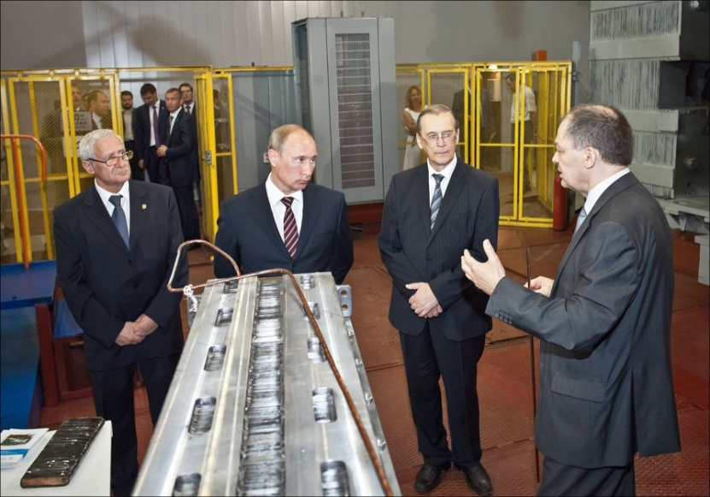
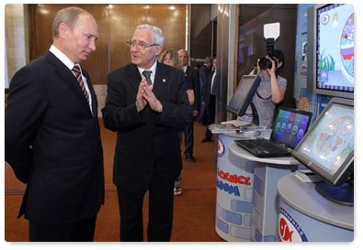
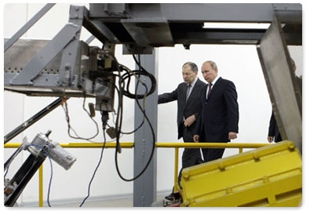
V. Putin visits the Veksler and Baldin Laboratory of High Energy Physics
5 July 2011
“To ensure a leadership we should rely on advanced technologies”. V. Putin
V. Matveev – 110th session of SC

Slide 16
Road Map of the NICA Facility
(under preparation at VBLHEP)
Objective 1: to develop the advanced accelerator experimental complex NICA and to produce, on its basis, new knowledge in the field of phase transitions, new states of hadron matter, and nucleon spin structure
Task 1.1 Accelerator complex
Task 1.2. Experiments with Nuclotron extracted beams
Task 1.3. Multipurpose set-up MPD for research of dense baryonic matter at NICA
interacting beams
Task 1.4. Multipurpose set-up SPD for studies of nucleon spin structure at NICA
interacting beams
Task 1.5. Research and engineering infrastructure
Objective 2: NICA International Multi-Access Centre;
Innovation and Educational Programmes
Task 2.1. Experimental zones and facilities for innovative research
Task 2.2. Development of the infrastructure of the NICA international
Muliti-Access Centre
Task 2.3. Development of modern educational environment of continuous studies and training of highly qualified staff
V. Matveev – 110th session of SC

Slide 17
Basic principles of the JINR Directorate’s policy
Continuity in the scientific policy of JINR and principles of its development that lay the basis for the “Road Map” and the 7-year plan for 2010-2016.
Adherence to the financial policy approved by the CP and aimed at concentration of finances and their efficient use for successful achievement of the tasks of the 7-year plan of development of all basic facilities of JINR.
Increase in work efficiency at all JINR departments and divisions.
Every possible strengthening and development of ties with institutions and scientific communities of JINR Member States and Associate Members, consideration of their interests in JINR plans and activities.
V. Matveev – 110th session of SC

Slide 18
Basic principles of the JINR Directorate’s policy
Continuing the course to establish and develop
partner ties with organizations in the EC,
implementation of specific measures to integrate JINR
into the European research infrastructure.
Work-out of plans to maximize activities at existing
and future facilities of JINR in the interests of
interdisciplinary sciences, in particular, in
Astroparticle Physics, Life Sciences, Medical Physics,
Atomic and Molecular Physics, etc.
Development of the JINR Information and Computing
Complex on a priority basis.
Development and efficient use of the JINR innovative
capability and of the JINR educational programme, to
the benefit of JINR Member States.
V. Matveev – 110th session of SC

Slide 19
CONCLUSION
In conclusion, I would like to express my confidence that the current Directorate team, which leads the Institute and its Laboratories, is undoubtedly capable, with the support of the Scientific Council and the Committee of Plenipotentiaries, to implement the planned programme of the Institute in all its major areas in the nearest years and to outline an exciting vision of its future development.
Thank you!
V. Matveev – 110th session of SC

