Slide 1

Asymmetric quasifission in reactions with heavy ions
Knyazheva G.N.
Flerov Laboratory of Nuclear Reactions
TAN 11, Sochi, Russia

Slide 2
Compound nucleus
n
n
ER
capture
n
n
touching
point
Quasi-elastic&
Deep-inelastic
Quasi-fission
CN fission

Slide 3
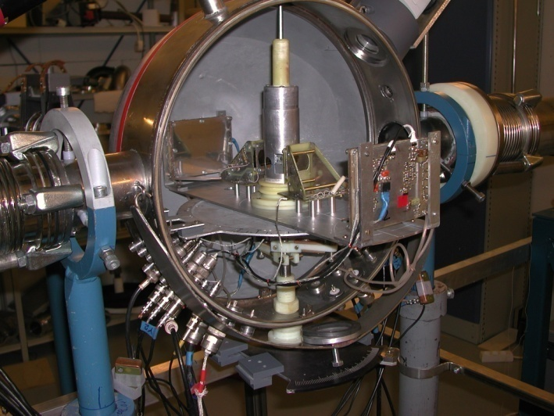
CORSET: correlation set-up for the measurements of the velocities of binary fragments
Measured values:
V1lab, V2lab, θ1lab, θ2lab
Extracted values: Mass, Energy, TKE, θcm for the both fragments

Slide 4
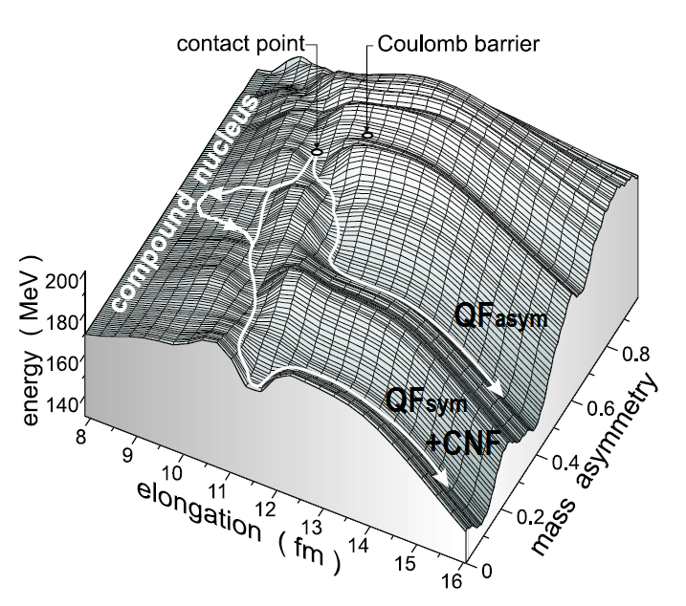
Heavy ion-induced reactions: binary channel
~10⁻²¹s
QFasym
~10⁻²⁰s
QFsym+CNF

Slide 5
Competition between fusion and QF processes: Hs (Z=108) composite systems
Z₁Z₂=980 1152 1472 2132

Slide 6
Presence of asymmetric QF in the medium composite systems (A~190-230u)
Z₁Z₂=492 1360

Slide 7
Asymmetric QF in the syperheavy composite systems

Slide 8
The positions of heavy peaks in the primary mass distributions of asymmetric QF fragments in reactions with heavy ions
Reactions | Z₁Z₂ | <M_{H}> | <M_{H}shells> | Reference
³⁰Si+²³⁸U | 1288 | 178 | 199,3 | Nishio et al. (EXON09)
³⁶S+²³⁸U | 1472 | 200±3 | 202,5 | Nishio, Itkis(PRC83)
⁴⁰Ar+²³⁸U | 1656 | 204 | 204,5 | Nishio et al. (EXON09)
⁴⁸Ca+²³⁸U | 1840 | 208±3 | 208,5 | Kozulin et al.(PLB683)
⁴⁸Ca+²⁴⁴Pu | 1880 | 210±3 | 211,8 | Itkis et al. (NPA787)
⁴⁸Ca+²⁴⁸Cm | 1920 | 211±3 | 213,8 | Itkis et al. (NPA787)
⁶⁴Ni+²³⁸U | 2576 | 215±3 | 216,5 | Kozulin et al.(PLB686)
< M_{H}shells>=((M_{CN}-M_{Z=28})+(M_{CN}-M_{N=50})+M_{Z=82}+M_{N=126})/4

Slide 9
The widths of Qfasym mass distributions
While the relative contribution of QF
to the capture cross section mainly depends on the reaction entrance channel properties, such as mass-asymmetry, collision energy, deformation of interacting nuclei and the Coulomb factor Z₁Z₂, the features of asymmetric QF are determined essentially by the driving potential of composite system.

Slide 10
Asymmetric QF
Normal
Reverse
Ca
Cm
U
Cm
QF
Z≈106
Z=28
N=50
N=126
Z=82
N=126
Z=82

Slide 11
Asymmetric QF
Reverse
Xe
Cm
U
Cm
Z≈106
N=184
N=50
Z=114
N=126
Z=82

Slide 12
Summary
While the relative contribution of QF to the capture cross section mainly depends on the reaction entrance channel properties, the features of asymmetric QF are determined essentially by the driving potential of a composite system.
The major part of the asymmetric QF fragments peaks around the region of the Z=82 and N=126 (double magic lead) and (Z=28 and N=50) shells, and the maximum of the yield of the QF component is a mixing between all these shells. Hence, shell effects are everywhere present and determine the basic characteristics of fragment mass distributions.
An alternative way for further progress in SHE can be achieved using the deep-inelastic or QF reactions. To estimate the formation probabilities of SHE in these reactions the additional investigations are needed.

Slide 13
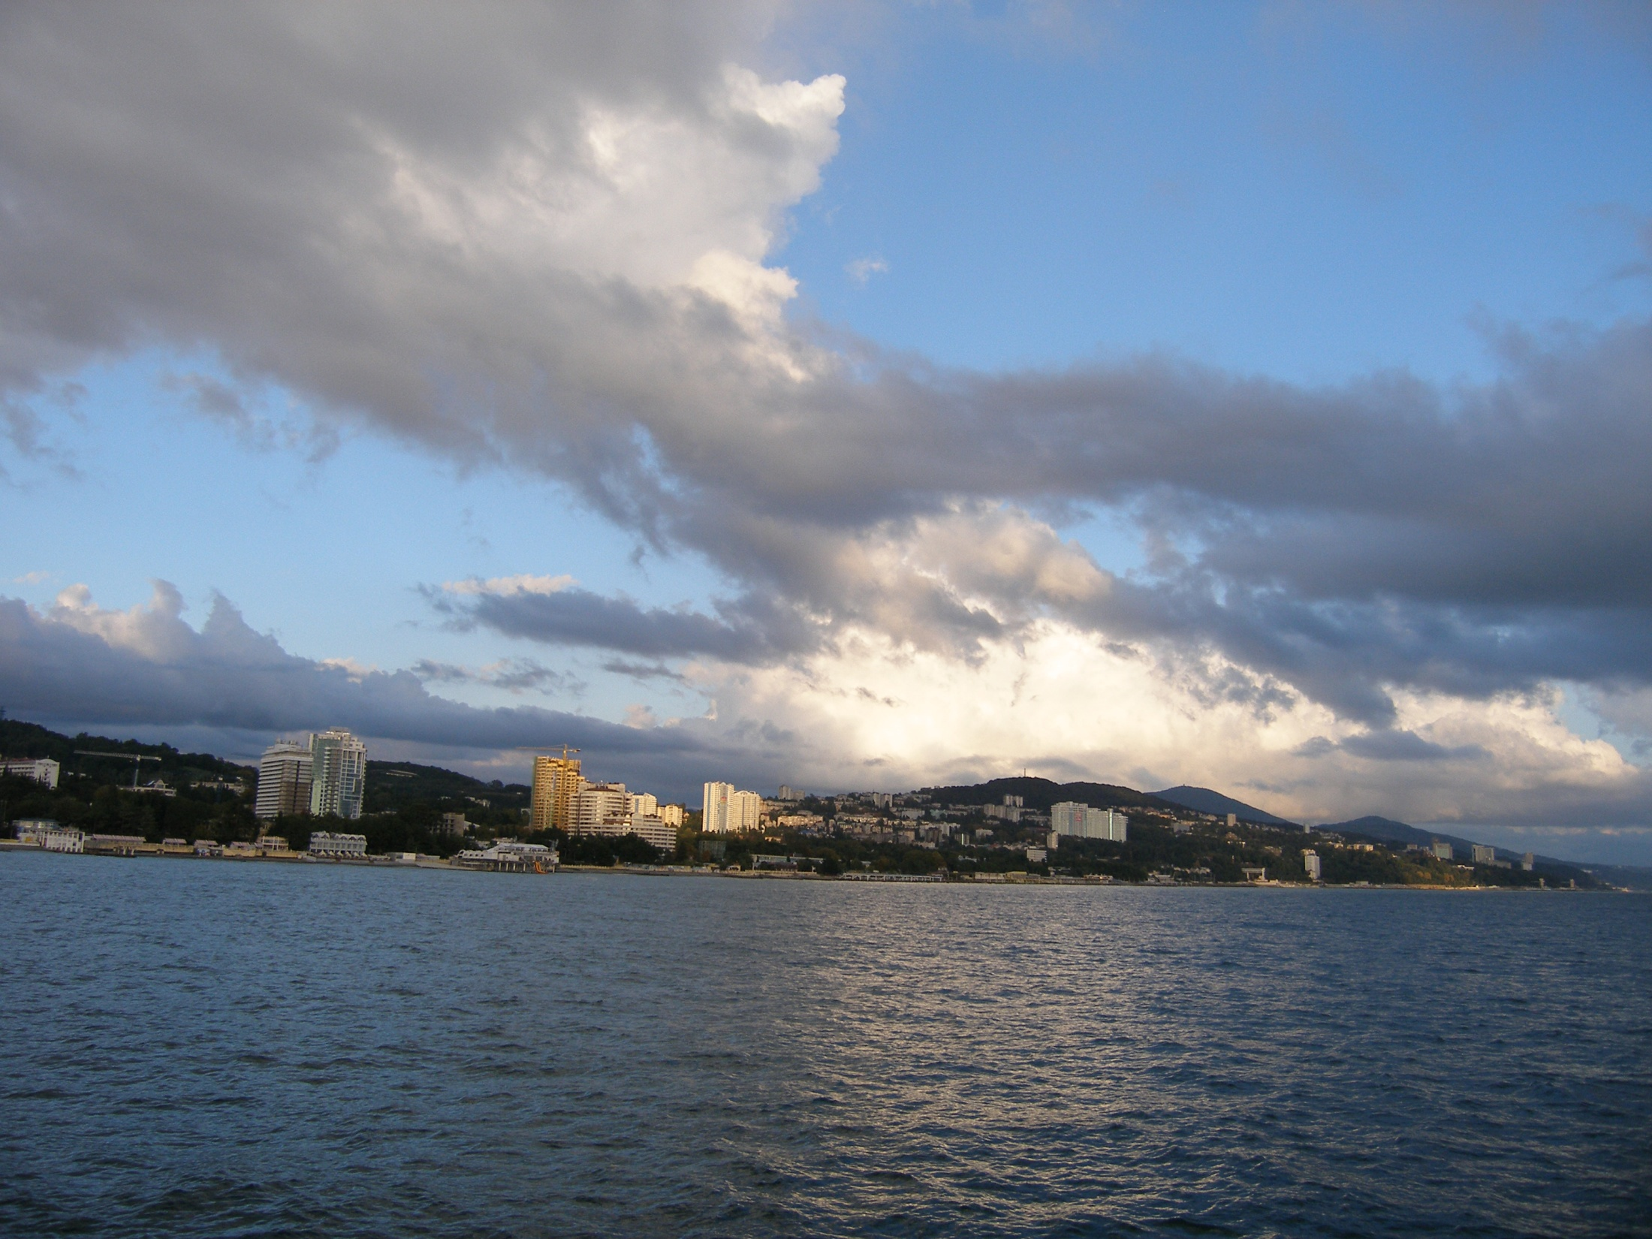
Collaboration
I.M. Itkis, M.G. Itkis, G.N.Knyazheva, E.M. Kozulin, A.A. Bogachev, T. Loktev, S. Smirnov
Flerov Laboratory of Nuclear Reactions, JINR, Dubna, Russia
F.Goennenwein
Physikalisches Institut, Universität Tübingen, 72076 Germany
E. Vardaci
INFN and Dipartamento di Scienze Fisiche dell‘Universita di Napoli, Napoli, Italy
F. Hanappe
Universite Libre de Bruxelles, Bruxelles, Belgium
O. Dorvaux, L. Stuttge
Institut de Recherches Subatomiques, Strasbourg, France
V. Rubchenya, W. Trzaska, J. Austo
Department of Physics, University of Jyväskylä, Finland
Thank you for your attention!

