Slide 1
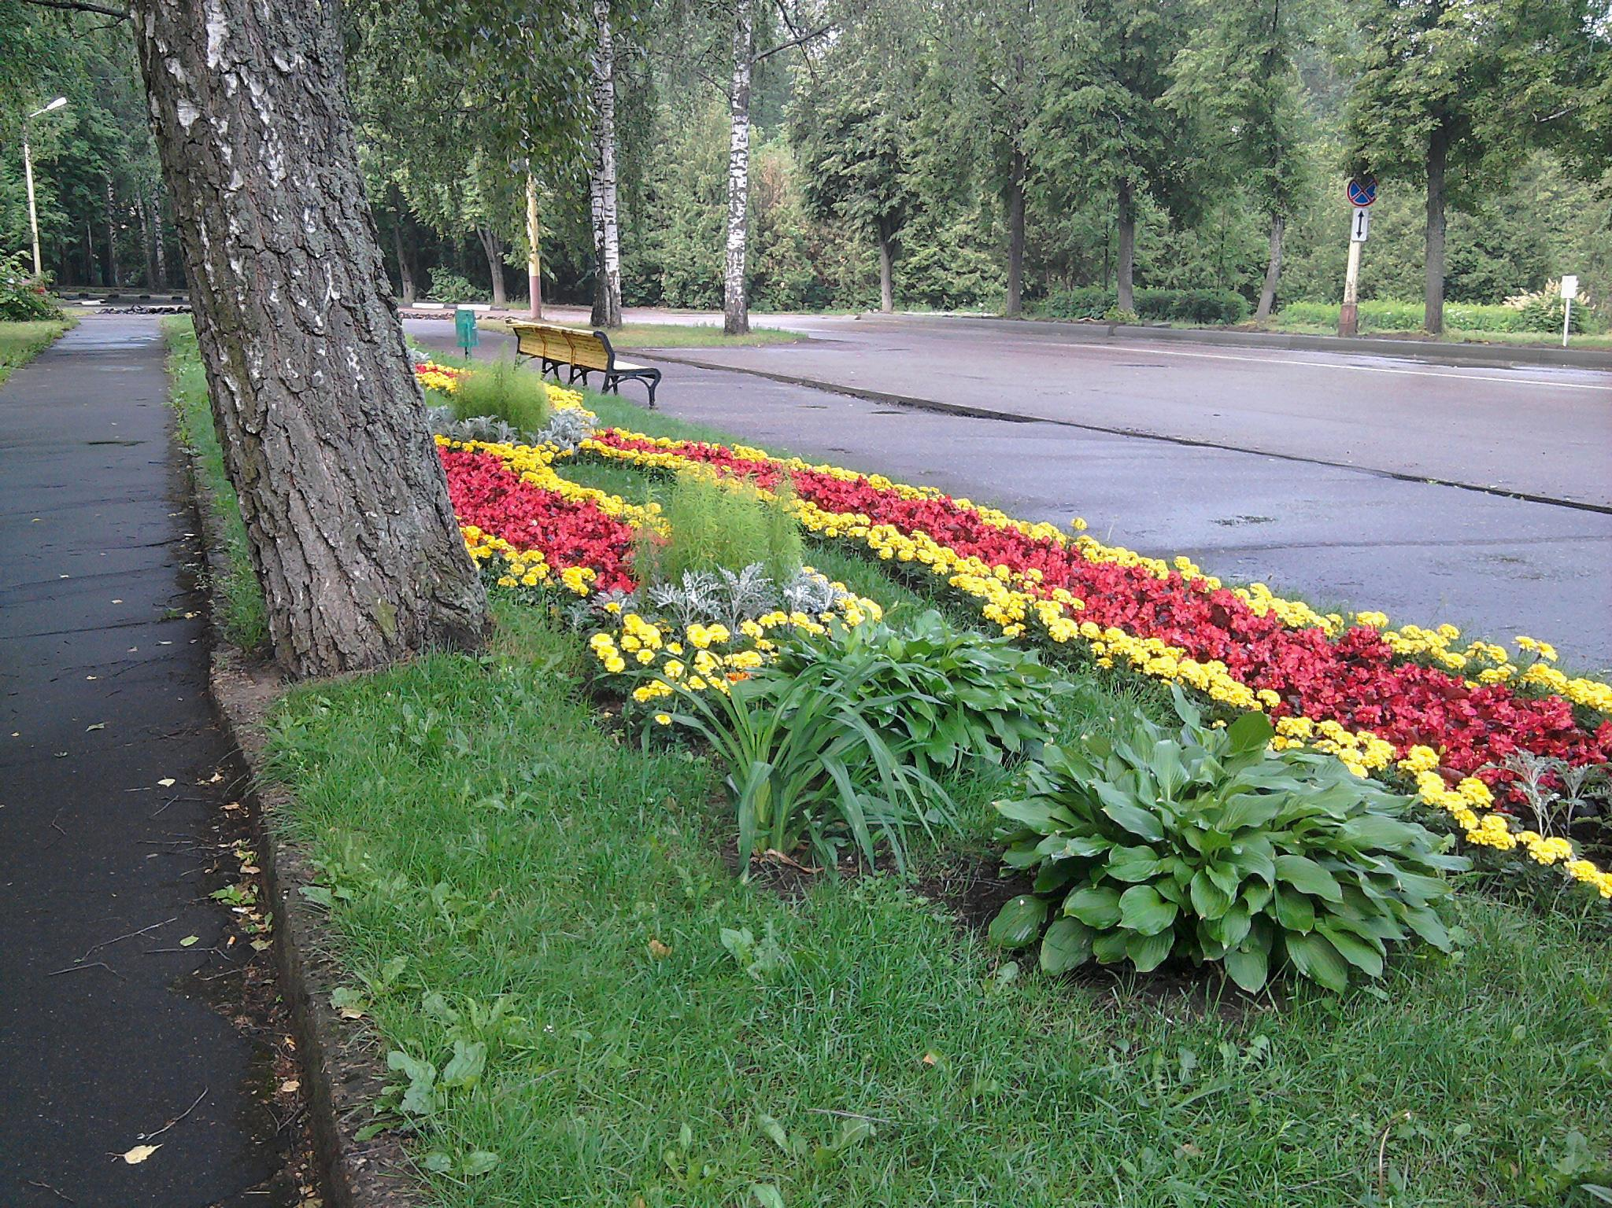
PAC on PARTICLE PHYSICS
35th meeting, June 22-23, 2011
Recommandations and work towards the optimisation of the research programme
Egle Tomasi-Gustafsson
Scientific Council, Dubna, 15/IX/2011

Slide 2
Recommendations on the Nuclotron-NICA projects
G. Trubnikov
The PAC appreciates the active progress in designing and developing elements and prototypes of the NICA complex, …. superconducting magnet prototypes, …the ion and polarized particle sources ….designing the collider lattice.
The PAC welcomes the productive cooperation with IHEP (Protvino) and the State Nuclear Centre (Sarov) on Heavy-Ion Linac, with the Budker INP (Novosibirsk) on RF, cooling and magnetic systems, with the State Specialized Design Institute (Moscow) on the TDR, with CERN, GSI, IKP FZJ.
The PAC concurs with the recommendations of the NICA Machine Advisory Committee taken at its meeting on 7 June 2011.
…international call for experiments at the Nuclotron-M

Slide 3
Recommendations on the progress towards the NICA White Paper (I)
A. Sorin
The PAC appreciates the significant progress of this work
New editorial section summarizing the main physical phenomena and the main parameters of the NICA facility including Nuclotron-NICA extracted beams.
broad international involvement in the preparation of this document,
The PAC recommends continuation of this work including the traditional round-table discussions of the future research programmes at NICA/MPD and Nuclotron-NICA.

Slide 4
Recommendations on the MPD project
V. Kolesnikov
The PAC appreciates the significant progress achieved in designing the MPD detector, in developing new technologies for its elements, and in simulation and feasibility studies. The beginning of prototyping of the MPD subsystems is also noted.

Slide 5
Recommendations on future scientific activities and proposal of experiments at Nuclotron-NICA
V. Kekelidze
Research programme …using the Nuclotron extracted beams
The PAC endorses this programme and considers its realization in the announced terms to be extremely important. Taking into account the intensive schedule for the commissioning of the experimental set-ups on the Nuclotron extracted beams, the PAC recommends that the project to study the hot dense baryonic matter be presented at the next PAC meeting.

Slide 6
Recommendations for new projects (I)
NA61/NA49 (G. Melkumov) : heavy-ion, neutrino and cosmology
In view of the important results which are foreseen in the future, the PAC reccommends
unification of the two JINR groups
should be reinforced by young scientists and PhD students.
…. the PAC looks forward to the implementation of this recommendation and to the presentation of this project at its next meeting before final approval.

Slide 7
Recommendations on the projects proposed for continuation (II)
D0 (G. Alexeev)
CDF (V. Glagolev).
extension until the end of 2014, with first priority.

Slide 8
Recommendations on the projects proposed for continuation (III)
The PAC takes note of the report on the TUS project presented by L. Tkachev and recommends extension of JINR’s participation in this project until the end of 2014, with first priority.

Slide 9
Recommendations on the projects proposed for continuation (IV)
Daya Bay (D. Naumov)
…..recommends extension of JINR’s participation in this project until the end of 2014, with first priority.

Slide 10
V. Recommendations on the JINR contributions to LHC experiments
Scientific results of the CMS, ATLAS, and ALICE experiments presented by S. Shmatov, A. Cheplakov, and M. Vala.
Emphasizes the scientific significance of the results being obtained with the active participation of JINR physicists
Encourages the groups to strengthen their efforts in the data analysis and in the presentation of the results at international conferences.

Slide 11
V. Recommendations on the JINR contributions to LHC experiments
.
Future reports should focus on specific contributions and responsibilities of the JINR groups and include :
  a list of talks given at international conferences,
  a list of analysis notes submitted to the collaboration,
  a list of PhD students,
  a list of management duties and conveners of data calibration and analysis groups.

Slide 12
VII. Scientific reports
The PAC notes with interest the report “Muon g-2: current status “ presented by A. Dorokhov and thanks the speaker.
The PAC notes the report “Experimental study of strange matter production in heavy-ion collisions at the Nuclotron” by V. Ladygin, and invites him to present a proposal at the next meeting.

Slide 13
Recommendations on activities approved for completion in 2011 (I)
THERMALIZATION (E. Kokoulina- SVD-2 Collaboration).: multiple particle production by the in pp interactions with high multiplicity
…continuation of this activity within the SVD-2
Collaboration under theme 02-1-1086.
NA49 (G. Melkumov)
….closure of this project (→NA61/NA49).
BECQUEREL (P. Zarubin) peripheral fragmentation of light nuclei in nuclear emulsions:
….continuation of this activity under theme 02-1-1087.

Slide 14
Recommendations on activities approved for completion in 2011 (II)
Theme: “Physics and Engineering of Feedback Systems in Synchrotron” (V. Zhabitsky) :
…all the systems for the LHC Damper were designed and constructed
….developed jointly by CERN and JINR, built by JINR and by Russian Industry, …
The LHC Damper is used routinely during injection, ramp, and collisions.
The PAC highly appreciates the results of this successful activity, which received the JINR First Prize in 2010, and recommends its closure due to the achievement of the goals of this project.

Slide 15
VIII. Poster presentations by young scientists in the field of particle physics research
The PAC notes with interest the poster presentations in particle physics presented by young scientists from VBLHEP and LIT. It selected the poster “Design of the Nuclotron booster in the NICA project” presented by A. Tuzikov (VBLHEP) to be reported at the Scientific Council session.

Slide 16
IX. Agenda (next meeting jan 23-24)
Consideration of new projects (including NA61/NA49) and themes
Reports and recommendations on the projects to be completed in 2011
Report on progress towards the NICA White Paper
Status report on the Nuclotron-NICA and MPD projects as well as SPD proposal
Report on plans for future scientific activity and proposals of experiments at the Nuclotron-NICA complex
Reports on the scientific results obtained by the JINR groups in the LHC experiments and plans for their future upgrades.

Slide 17

Thank you for attention
Благодарю вас за внимание

Slide 18
D0
Achievements:
  First observation of cascade double strange baryon Ω_{b}
  multiple parton interactions in extended kinematical region =>Estimation of the double parton background to Higgs production at Tevatron.
  The instrumentation technique (MDT detectors and corresponding electronics) developed for the D0 project => applied for the muon system proposed for the SPD detector at NICA.
Request
  40 kE/year on 3 year (25 KE travel+15 kE material)
Programme
  Finalize studies in B-physics and QCD
  New physics (through multiple parton interactions)
  Parton distribution functions in a new kinematical region

Slide 19
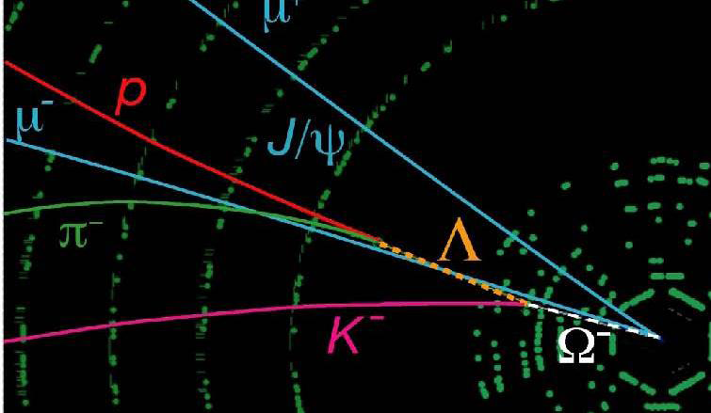
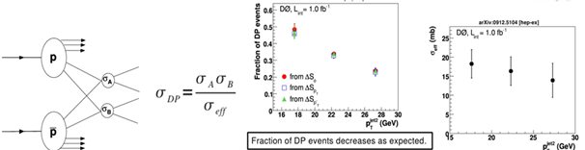
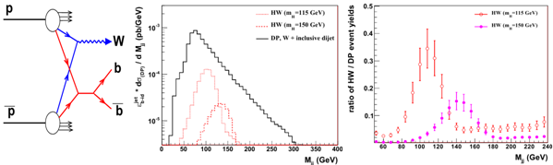
D0
Run 203929, Event 22881065, M(J/Psi+Ω) = 6.158 GeV/c2
PRL 101, 232002 (2008)

Slide 20
CDF
Results:
  Top Mass measurement
  Very High multiplicity processes(thermalization phenomena)
Contribution:
  Large Scintillator Counters of the CDF muon trigger 1 for heavy quark physics.
  Si-strip complex for secondary vertex trigger recognition 2 leading JINR responsabilities
  Data collection and analysis
Request (40 KE/year on 3 years)

Slide 21
Daya Bay
Contributed to:
  Gd-loaded scintillators, conception, creation and optimization, production technology;
  new method of PPO (LS fluorene) synthesis, production and commissioning (300 kEuro);
  investigation of comsogenic background
  design of anti-muon active veto system,
  in MC of complex processes associated with cosmic muons.
Plans :
  determination antineutrino detector energy response;
  determination of number of proton targets in LS,
  study of backgrounds;
  => First measurement of the parameter θ13

Slide 22
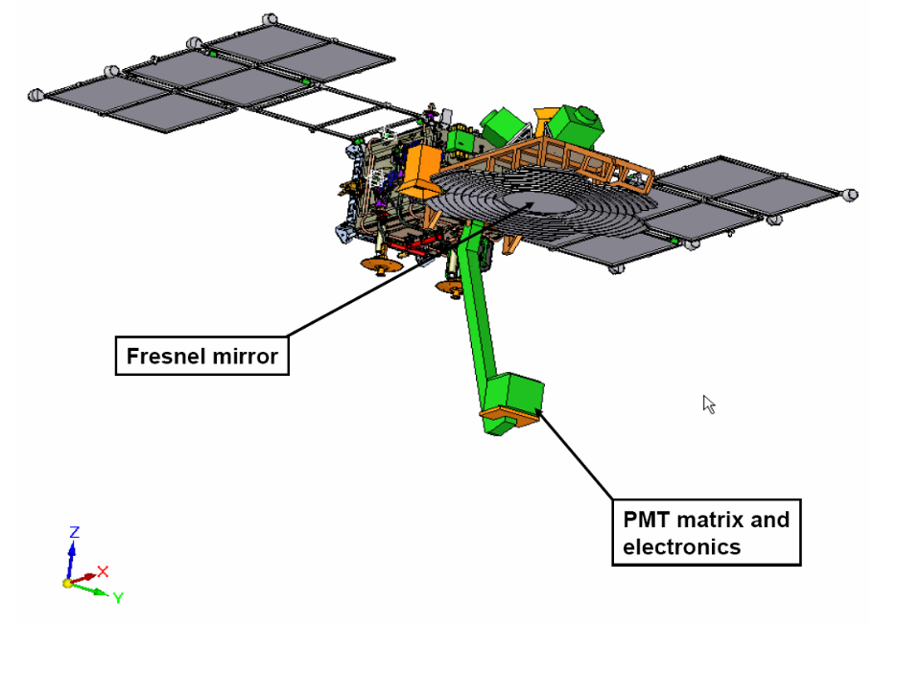
TUS
UHECR study by the measurement of EAS fluorescent radiation: observation of the full sky for primary particle arrival directions.
Astronomy and astrophysics with particle with energies 10²⁰ eV, extending, the measurement of the energy spectrum of the cosmic radiation beyond the (GZK) cut-off.
High energy neutrino astronomy. Phenomena intrinsic to the Earth‘s
atmosphere

Slide 23
TUS
TUS R&D completed in 2010.
Flight TUS apparatus production is in preparation: TUS mission is planned at the end of 2011 for 3 years of data taking.
The main JINR activity from now is to produce a set of the program packages including the event simulation with expected optical parameters, programs for on-board data processing and off-line physical analysis.
Full scale technological prototype of the Fresnel mirror was produced and tested in 2010 according to space qualification requirements - successfully tested at temperature ±80^{о}С and pressure 0.02 – 1.0 аtm
Next step: measurements of the Fresnel mirror system and evaluation of systematic uncertainties.

