Slide 1
Bruno Pontecorvo
Pontecorvo Prize is very special for us:
All the important works done by Super-Kamiokande point back to Bruno Pontecorvo
  1957 First idea of a Neutrino Osicllation
  1978 First idea to use atmospheric neutrinos to study neutrino oscillations (w/ Bilenky)
    S. M. Bilenky and B. Pontecorvo, Physics Report 42(1978) 225-261
  1946 First idea, a radio-chemical experiment, to detect solar neutrinos

Slide 2
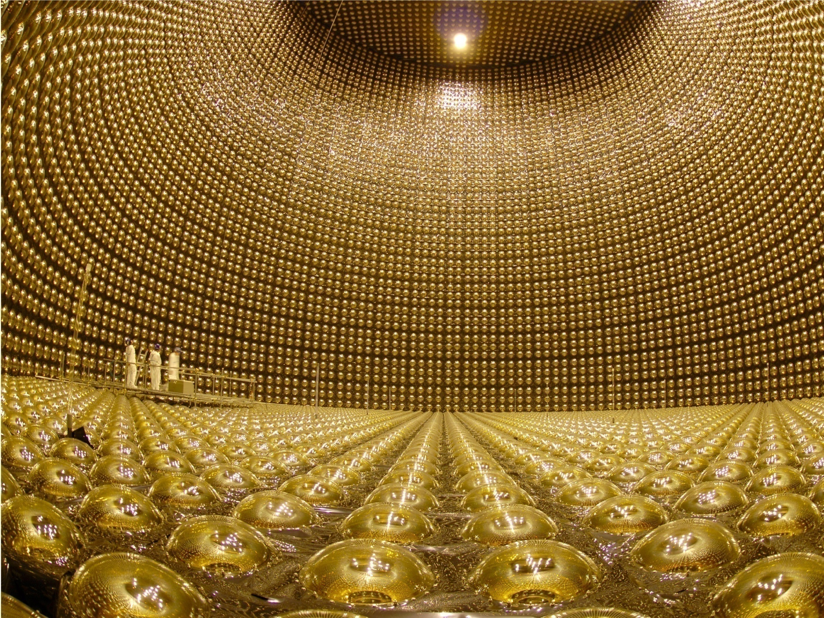
Super-Kamiokande and
Neutrino Oscillations
Y. Suzuki
Kamioka Observatory, Institute for Cosmic Ray Research, The University of Tokyo
and
Kamioka Satellite, Institute for the Physics and Mathematics of the Universe, Todai Institute for Advanced Study, The University of Tokyo

Slide 3
Pre-history
1991: Super-K construction started
Scientific backgrounds in late ‘80
  Two unresolved problems remained
    Solar Neutrino Problem (Homestake (Cl), Kamiokande)
    Atmospheric Neutrino Anomaly (Kamiokande)
  Aim at that time of Super-K
    Resolve those neutrino problems
    Supernova neutrinos
    Proton decay

Slide 4
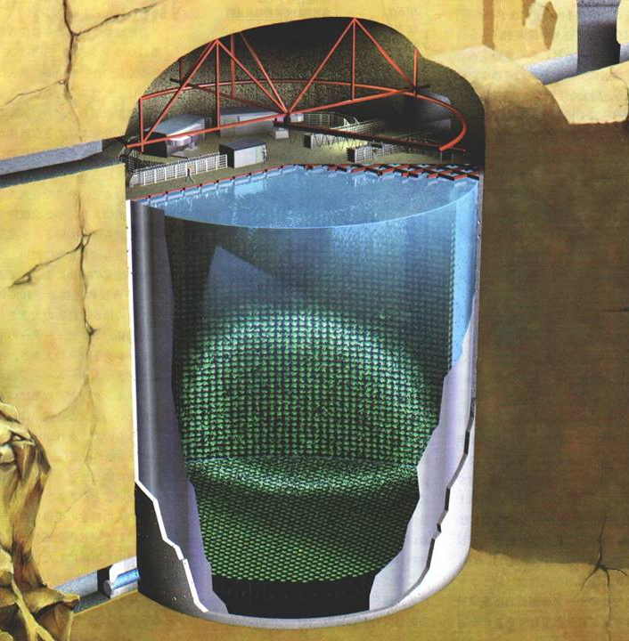
Super-Kamiokande
Detector
C Scientific American
50,000 tons of Imaging Water Cherenkov Detector
  Inner: 32,000 tons
  (Outer Vol: ~2.5 m thick)
  Fid. Vol: 22,500 tons
11,146 PMTs (ID)
  50 cm in diameter
  40% coverage
1,885 PMTs (OD)
  20 cm in diameter
1,000 m underground
ν
42m
39m
∼130 Collaborators from 36 inst. (5 countries)

Slide 5
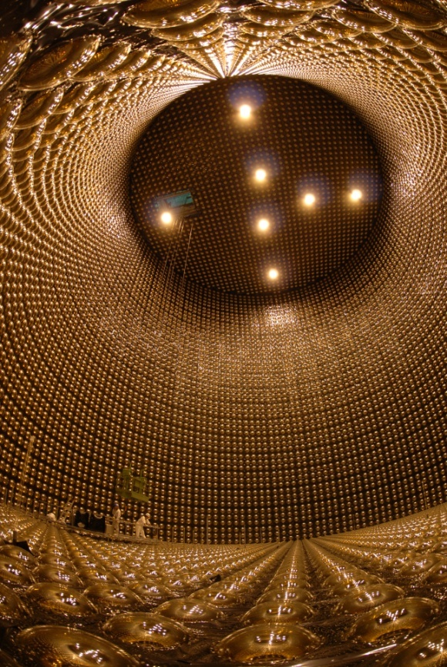
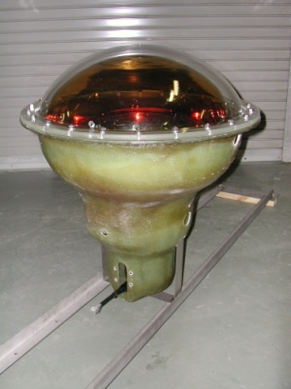
Brief history of Super-K
96 | 97 | 98 | 99 | 00 | 01 | 02 | 03 | 04 | 05 | 06 | 07 | 08 | 09 | 10
4
6
12
11
6
9
SK-I
SK-II
SK-III
SK-IV
(11,146 PMTs)
(5,182 PMTs)
(11,129 PMTs)
(11,129 PMTs)
K2K
T2K
4 phases: SK-I, SK-II, SK-III, SK-IV
  SK-I (11,146 PMTs (40% cov.))
    April-1996 → June-2001
  Accident (lost more than half of PMTs)
    Nov-12, 2001
  SK-II (5,182 PMTs (19% cov.))
    Dec-2002 → Nov-2005
  SK-III (11,129 PMTs (40% cov.))
    July-2006 → Sept-2008
  SK-IV (11,129 PMTs (40% cov., New Elec.))
    Sept-2008 →
K2K: March-1999 → Nov-2004
T2K: April 2009 →
SK-III
Protection case

Slide 6
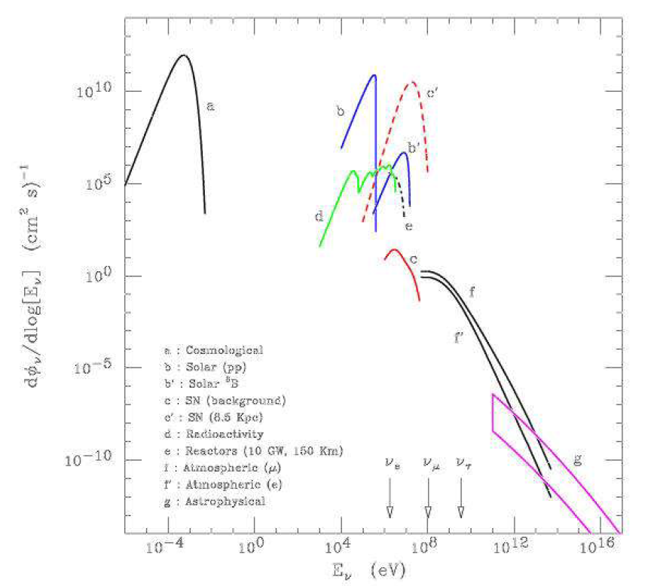
Energy coverage
Precise study of solar neutrinos
  5400 events /year with 5 MeV energy threshold
Precise study of Atmospheric Neutrinos
  3600 events /year
Look for neutrinos from supernovae
  > 8,000 events for SN at 10kpc distance
Look for SN relic Neutrinos
Energy threshold
E_{obs} > 4.5 MeV
Super-K
10
5
0
5
10
Solar
pp-ν
Supernova (8.5kpc)
Geo
-ν
Solar ⁸B-ν
log(E_{ν}φ_{ν} [/ cm² s sr])
Supernova
relic
Atmospheric ν
Astrophysical
1MeV 1GeV 1TeV 1PeV
log(E_{ν})
Look for Proton Decay
  Up to 10³³~10³⁴ years
Long baseline Neutrino Oscillation Experiments (later)

Slide 7
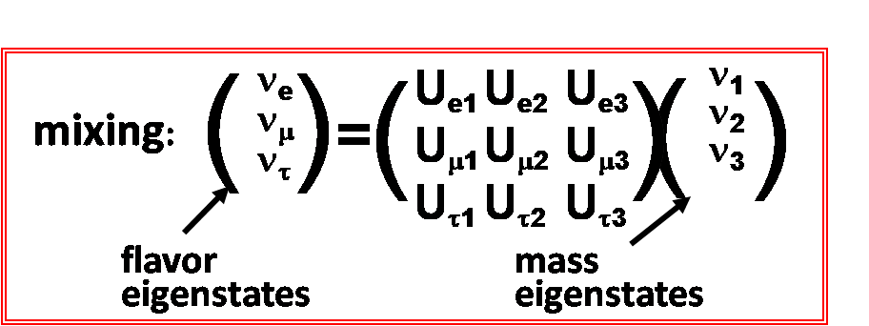
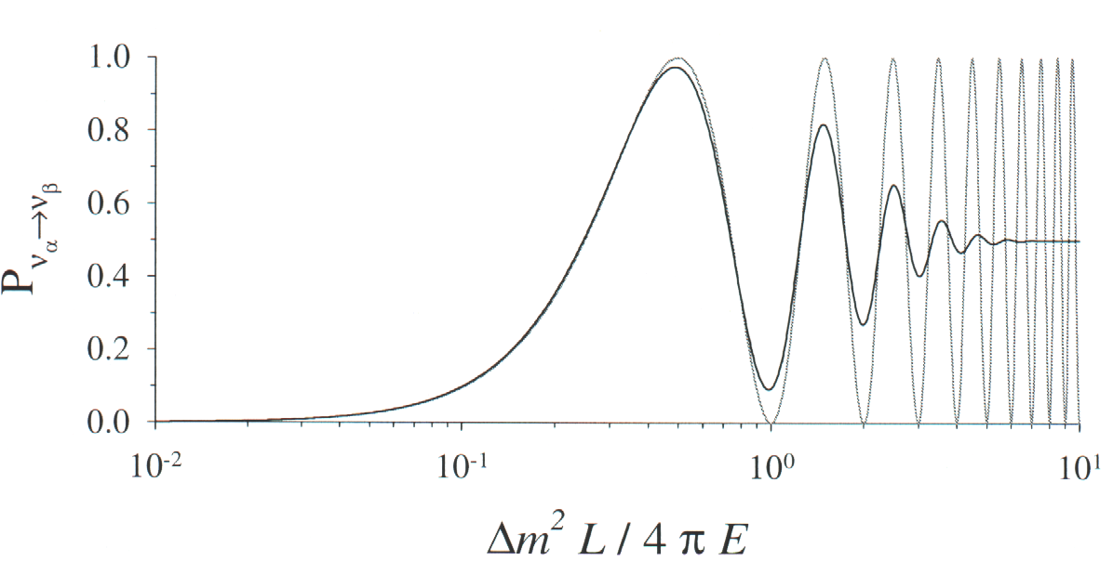
1 page introduction
Neutrino Oscillation
  Non-zero neutrino mass
  Mixing
Why Neutrino mass is interesting and important
Current model of the elementary particle physics
➔ assumes zero neutrino mass
Finite neutrino mass
  ➔ clue to a new theory for particle physcis
  (beyond the standard model)
The smallness of the neutrino mass
  ➔ suggest an existence of the energy scale of ∼10¹⁶GeV
  10⁻³⁴ sec after the Big Bang
➔ tool to study early Universe
λ = 4πE/ Δm²
Ex. Atmospheric ν
(∼1GeV, ∼2x10⁻³ eV²)
➔ λ/2 ∼500km

Slide 8
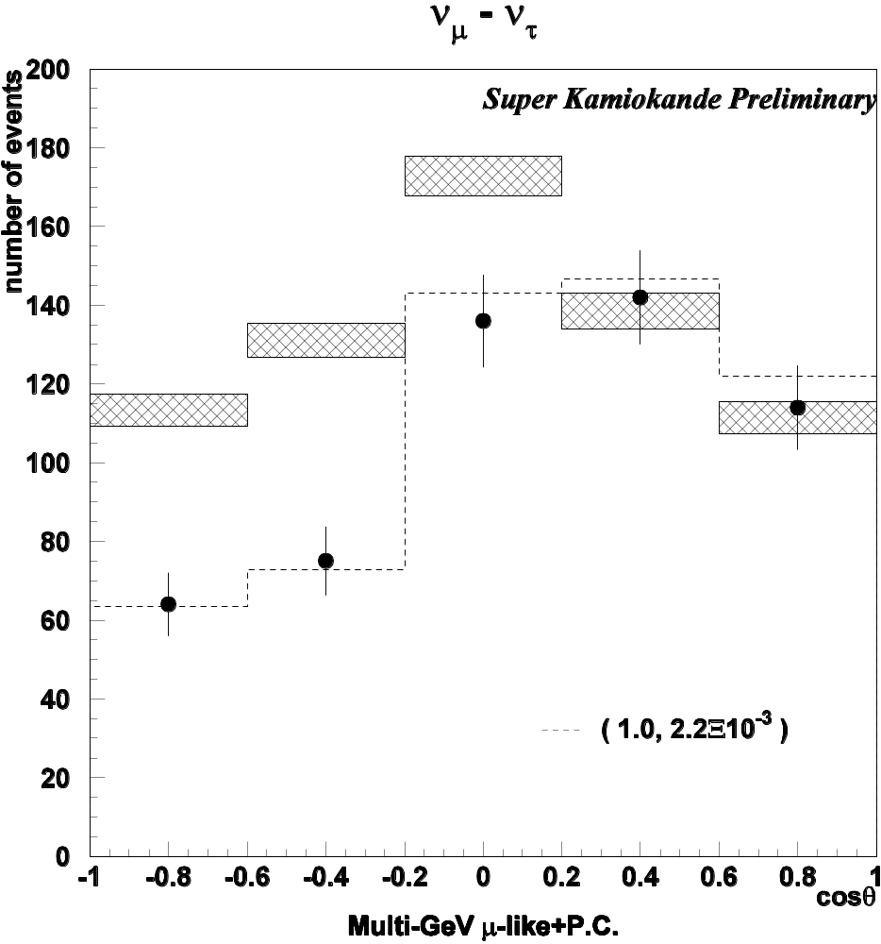
Discovery of Atmospheric Neutrino Oscillation
In 1998
SK observed
  Asymmetry in zenith angle distributions
  definitive evidence of the neutrino oscillation
  independent of the flux calculations
The result was accepted quickly and widely by the community.
(1.0, 2.2x10⁻³eV)
multi-GeV μ−like + PC
cos θ_{Z}
Up-going
Down-going

Slide 9
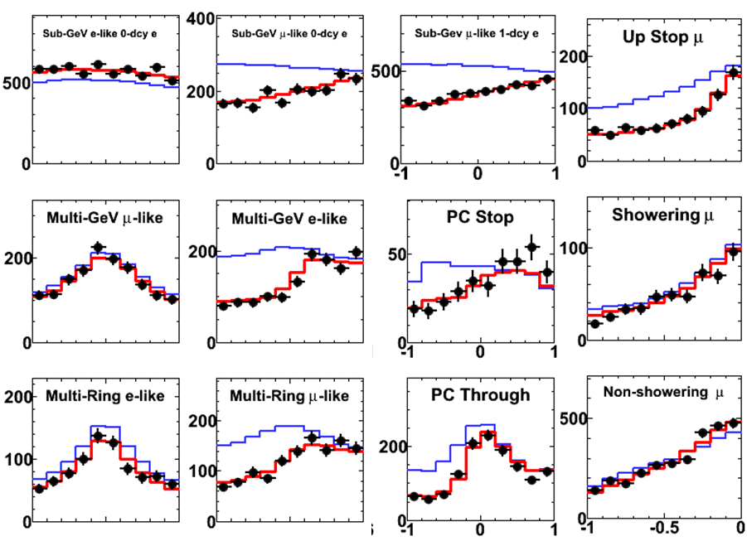
Latest Results (Super-K): 15 years
96 | 97 | 98 | 99 | 00 | 01 | 02 | 03 | 04 | 05 | 06 | 07 | 08 | 09 | 10
4
6
12
11
6
9
SK-I
SK-II
SK-III
SK-IV
(11,146 PMTs)
(5,182 PMTs)
(11,129 PMTs)
(11,129 PMTs)
e-like
μ-like
SK-I,II,III combined
2806days (173ktyr)
for FC+PC
  24841 events
3109days for up-μ
  4238 events
With this statistics, SK is now able to scrutinize subdominant effects, θ₁₃, CPV and so on in 3 flavor analysis
e
μ
High ENERGY Low
-1 1
-1 1
-1 1
0 1
cosθ
cosθ
cosθ
cosθ

Slide 10
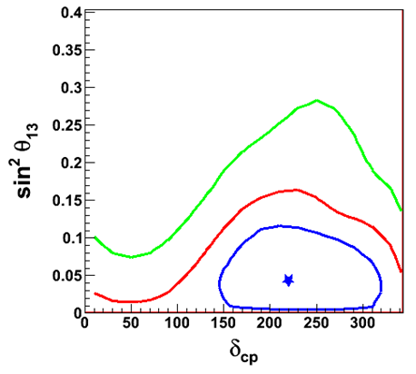
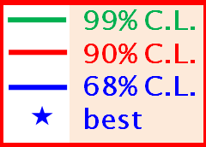
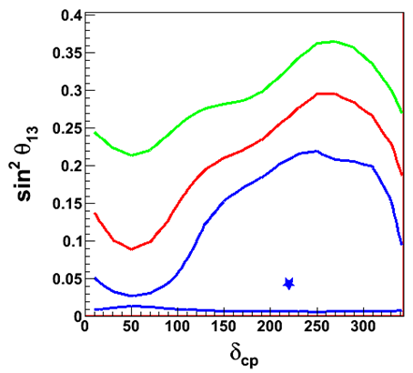
Subdominent effect in three flavour analysis
Inverted Mass Hierarchy
  The latest SK results indicate a small deviation of θ₁₃ from zero and a value for CP phase,
  although statistical significance (1σ) is low and it must be statistical fluctuation or may be something else.
But this observation definitely demonstrate that the high statistic measurement of atmospheric neutrinos will be important to study θ₁₃ and CPV in future.
Data
sin²θ₁₃
δcp
Sensitivity test
MC
sin²θ₁₃
δcp

Slide 11
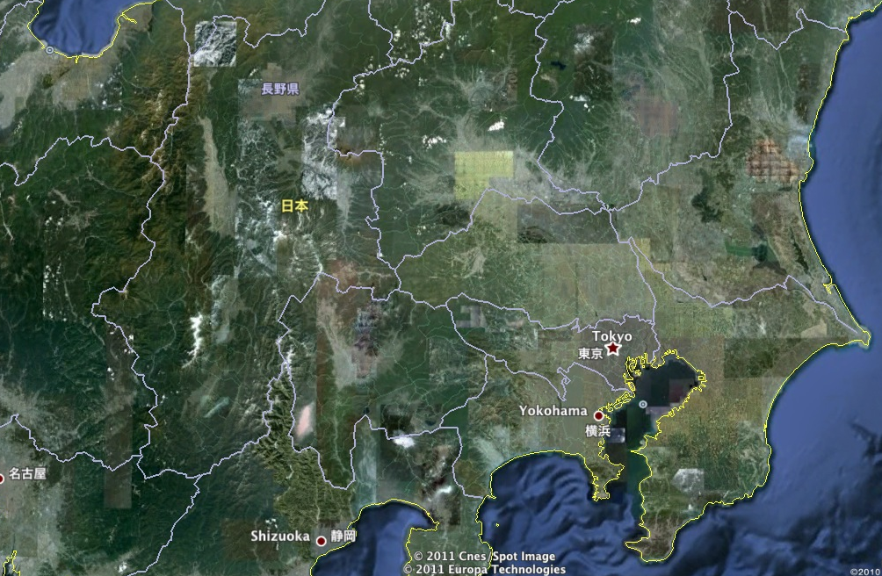
Towards K2K, T2K
Long baseline neutrino oscillation experiments
Super-K was used as a far detector for longbaseline neutrino oscillation experiments
K2K (KEK to kamioka) with 250km baseline using neutrinos from KEK 12 GeV PS, run between 1999 and 2004, confirmed atmospheric neutrino oscillations.
T2K: 295 km
JPARC
Super
-Kamiokande
K2K: 250 km
KEK
TOKYO
T2K (Tokai to Kamioka) uses newly build JPARC 40 GeV Accelerator with 295km baseline has started in 2010 aiming to discover theta 13

Slide 12
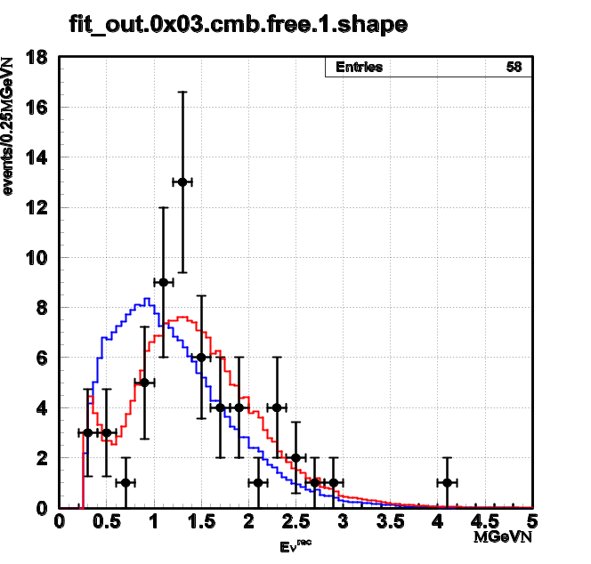
Towards K2K, T2K
Long baseline neutrino oscillation experiments
k
Κ2Κ
∼0.92x 10²⁰ POT
Total observed
neutrino int.:
112 events
Predicted
155.9 ev
(for no oscillation)
➔ 71% survive
Super-K was used as a far detector for longbaseline neutrino oscillation experiments
K2K (KEK to kamioka) with 250km baseline using neutrinos from KEK 12 GeV PS, run between 1999 and 2004, confirmed atmospheric neutrino oscillations.
1R-μ spectrum
No oscillation
Oscillation
Eν^{recon}
MeV
Predicted survival prob. for L=250 km, <Eν>∼1.3 GeV
Δm²=2.5x10⁻³eV², :70% survival ⬄ Obs.: 71%
(in physical region)
sin²2θ = 1.0, Δm² = (2.76 ± 0.36)x10⁻³eV²
T2K (Tokai to Kamioka) uses newly build JPARC 40 GeV Accelerator with 295km baseline has started in 2010 aiming to discover theta 13

Slide 13
Towards K2K, T2K
Long baseline neutrino oscillation experiments
Super-K was used as a far detector for longbaseline neutrino oscillation experiments
K2K (KEK to kamioka) with 250km baseline using neutrinos from KEK 12 GeV PS, run between 1999 and 2004, confirmed atmospheric neutrino oscillations.
T2K: 295 km
JPARC
Super
-Kamiokande
K2K: 250 km
KEK
TOKYO
T2K (Tokai to Kamioka) uses newly build JPARC 40 GeV Accelerator with 295km baseline has started in 2010 aiming to discover θ₁₃

Slide 14
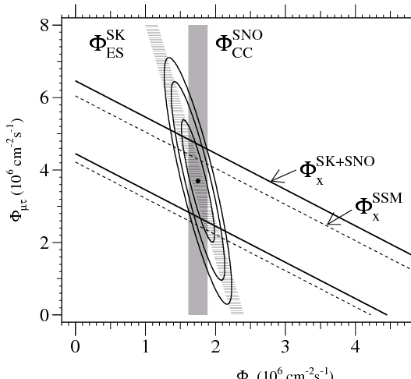
Solar Neutrino Oscillation
June 18th was a very special day for us for the solar neutrino oscillation
SK 1258 days ES flux: PRL86 in June 18, 2001 issue
  ν + e → ν + e 2.35 ± 0.02 ± 0.08 x 10⁶ cm⁻²s⁻¹
SNO CC results: announcement in June 18, 2001
  ν_{e} + d → p + p + e⁻ 1.76 ± 0.06 ± 0.09 x 10⁶ cm⁻²s⁻¹
SNO (ν_{e}) +SK (ν_{e} + (ν_{μ} + ν_{τ} )x0.15)
  4.3 σ effect of the existence of
  non-electron neutrino
  components in solar neutrinos
  on the earth
Evidence of Neutrino Oscillation

Slide 15
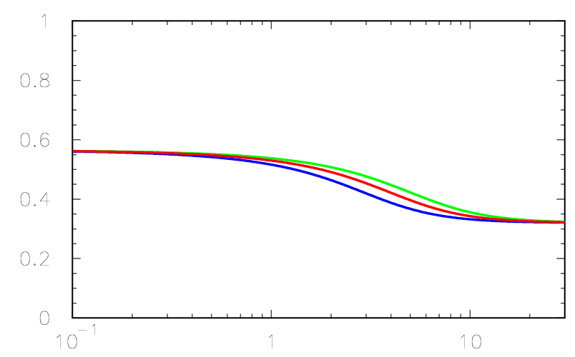
Large Mixing Angle Solution
We now know that LMA is responsible for the solar neutrino oscillation, where the oscillation is ‘vacuum’ in low energy and Matter effect dominates in high energy (>5 MeV):
The transition region:
  (2∼5 MeV)
➔ sensitive to Δm²
➔ good place to look for
some exotics
1.0
1-(1/2)sin²2θ
Guide
Line
0.8
Ga−(⁸B+⁷Be)
Bor:⁷Be
0.6
Survival prob. P(ν_{e}→ν_{e})
Bor:⁸B (P_{ee})
0.4
SK: P_{ee}
Cl−(⁸B)
sin²θ₁₂ = 0.32
Δm² =9.6×10⁻⁵ eV²
Δm² =7.6×10⁻⁵ eV²
Δm² =5.6×10⁻⁵ eV²
SNO CC
0.2
sin²θ
0
0.1 1 10
Neutrino energy [MeV]

Slide 16
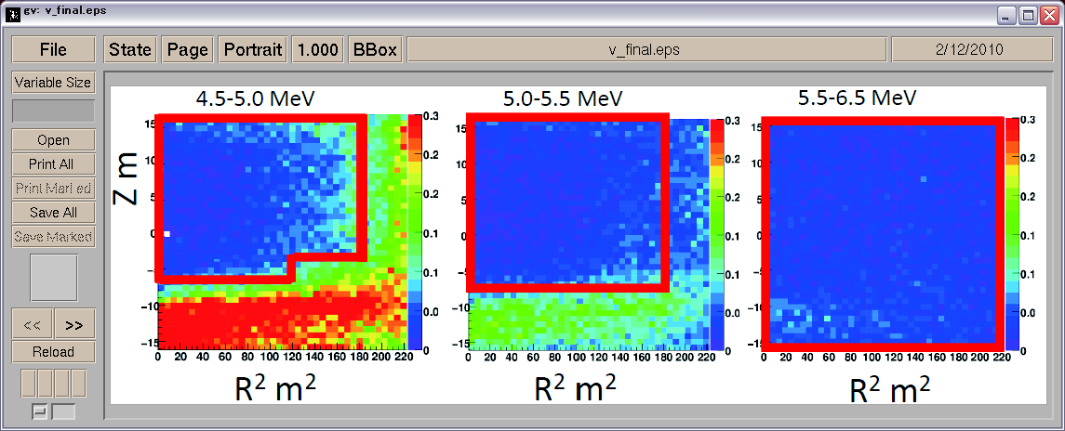
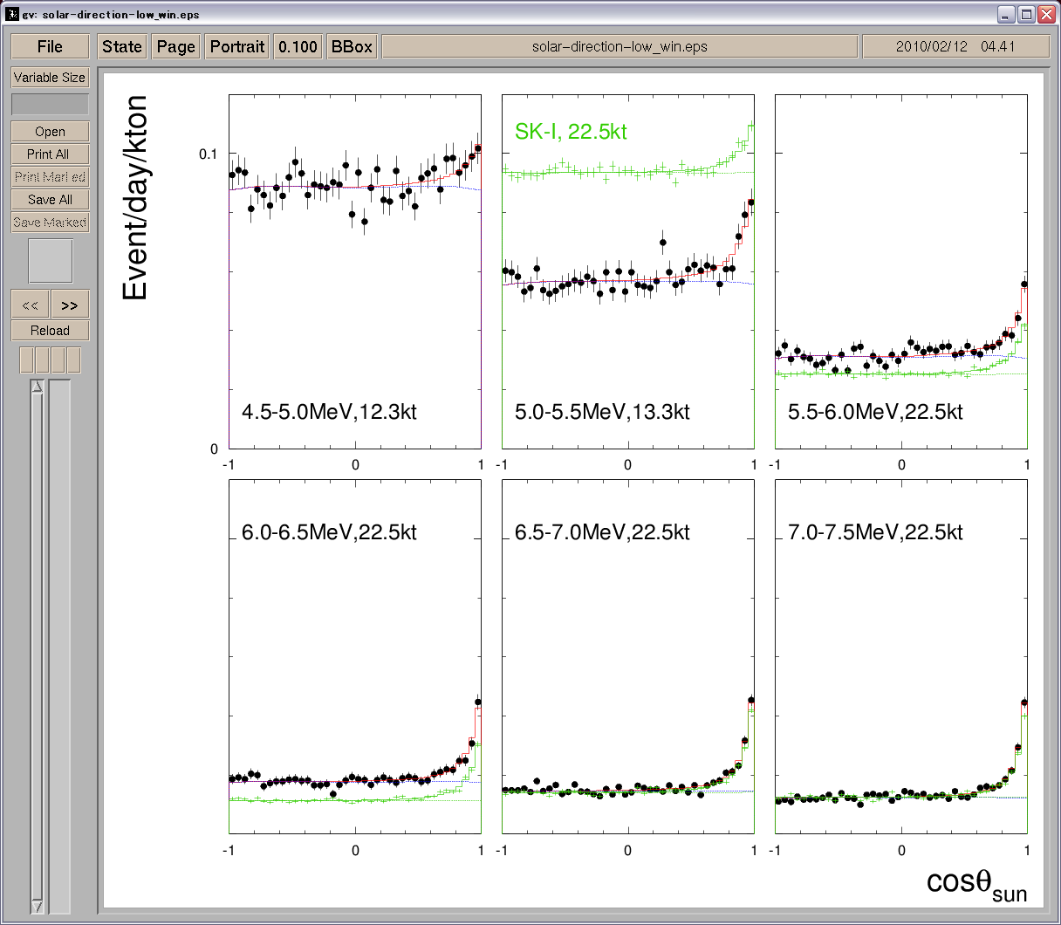
Lowering the energy threshold
96 | 97 | 98 | 99 | 00 | 01 | 02 | 03 | 04 | 05 | 06 | 07 | 08 | 09 | 10
4
6
12
11
6
9
SK-I
SK-II
SK-III
SK-IV
(11,146 PMTs)
Lower the energy
(5,182 PMTs)
(11,129 PMTs)
(11,129 PMTs)
SK-IV
New electronics (’08-Sep-09 ➔)
  Record all the pulses inc. noise;
  ➔ Software trigger
Lower background was achieved
Threshold:
➔ 3.5 MeV(K.E.)
Limit the fiducial volume
SK-III
4.5 MeV – 5 MeV
4.0 MeV – 4.5 MeV
cos θsun
cos θsun

Slide 17
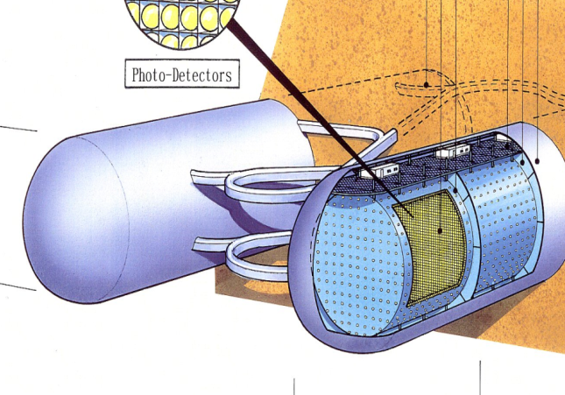
The mission may continue to the Next generation detector, Hyper-Kamiokande and beyond
Tie up with the accelerator neutrino beam
  Study on CP Violation in neutrino sector
    Leads to the origin of matter in the Universe
Supernova neutrinos
  200k neutrino events for SN at 8kpc
    250 ν_{e} from neutronization burst
    θ₁₃ sensitivity to sin²θ₁₃<10⁻⁴
Proton decay
  10³⁵ yrs for p→eπ⁰ mode
  Step into the discovery region
Hyper-Kamiokande
Fiducial mass 540kt
  ← 22.5 kton: Super-K (x20)
Precise study on solar and atmospheric neutrinos

Slide 18
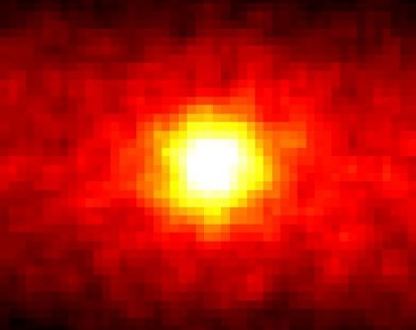
Epilogue
I am very grad to have a chance to participate the discovery of the neutrino oscillations.
Our mission will contine in future to understand how the matter in the universe was created.
I am really grateful to receive this prestageous prize and thank you for all your suport for us.
Image of the sun by neutrinos
(Neutrino Heliography)
Super-Kamiokande

