Slide 1

A SYSTEM FOR MEASUREMENT
OF A THERAPEUTIC PROTON BEAM
DOSE DISTRIBUTION
Научно-практический центр протонной лучевой терапии и радиохирургии (Москва-Дубна)
Agapov Alexey
Medico-Technical Complex of Laboratory for Nuclear Problems

Slide 2
Proton Therapy Facility
Situation in Russia
Научно-практический центр протонной лучевой терапии и радиохирургии (Москва-Дубна)
Today, radiotherapy applies in 70% of all oncological treatment cases. For about 30% of them the proton therapy is the best technique.
Three centers of proton beam therapy based on physical accelerators exist in Russia:
ITHEP (Moscow)
PNPI (St.Peterburg)
JINR (Dubna)
Development of new treatment methods is the first step to creation of the specialized centers in Russia

Slide 3
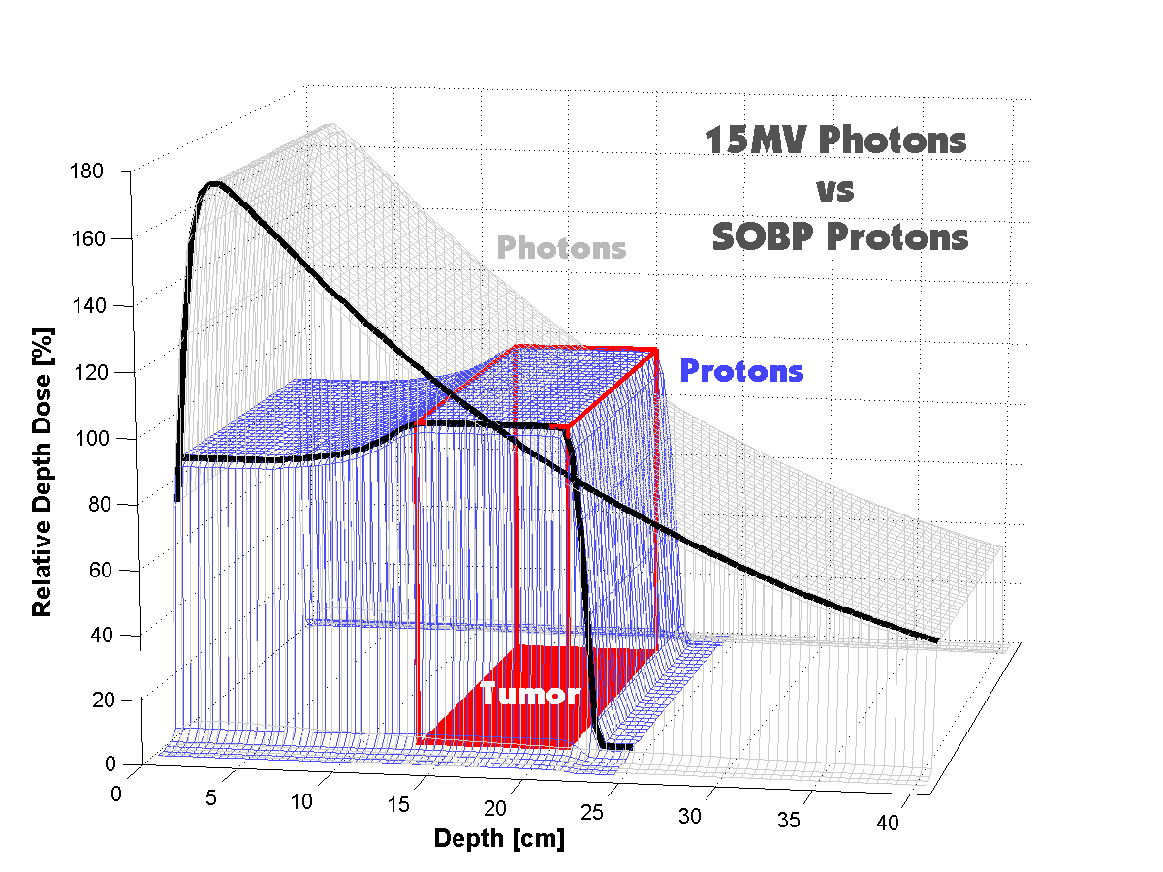
Comparison of depth-dose distributions of photon and proton
Научно-практический центр протонной лучевой терапии и радиохирургии (Москва-Дубна)
Protons have an advantage over photons:
they allow delivering a maximum dose to the deep located target (tumour).
This is especially important for some kind of tumours, e. g., brain tumours.

Slide 4
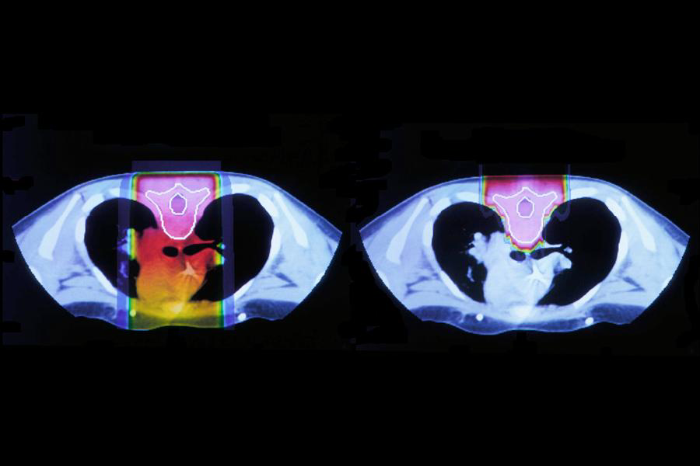
Comparison of depth-dose distributions of photon and proton
Научно-практический центр протонной лучевой терапии и радиохирургии (Москва-Дубна)
Single direction of irradiation
Photon beam
Proton beam

Slide 5
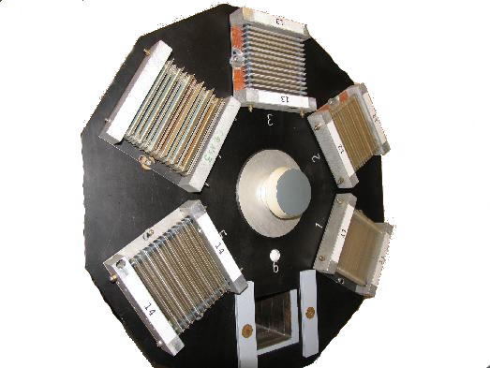
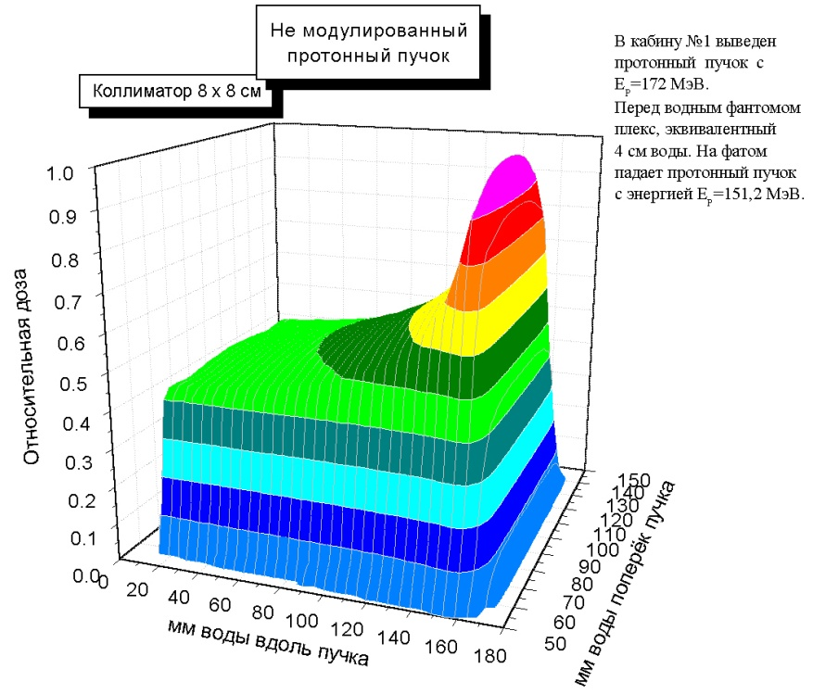
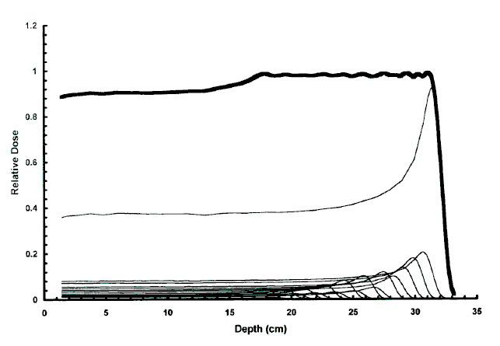
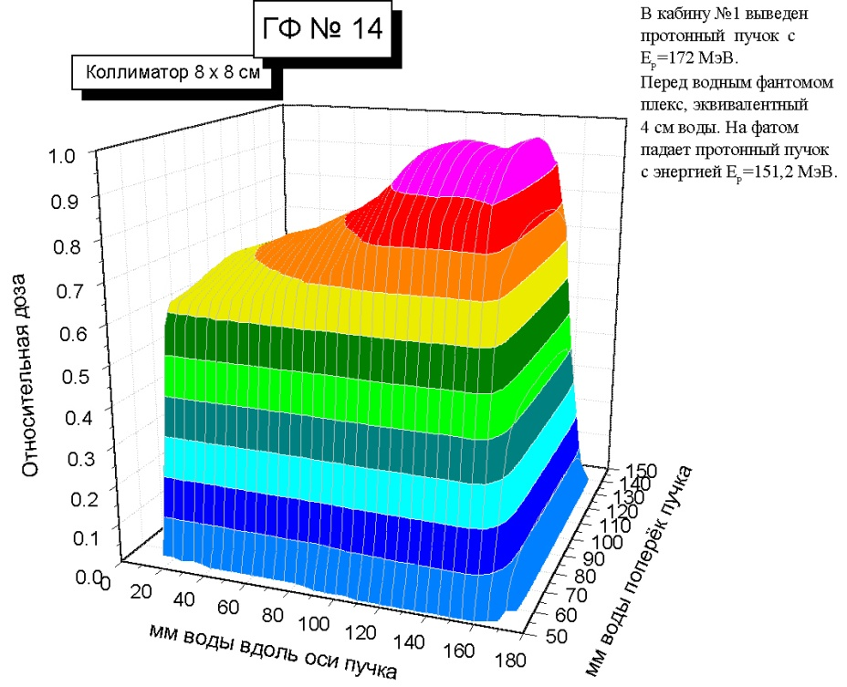
Spread-out Bragg peak (SOBP)
Научно-практический центр протонной лучевой терапии и радиохирургии (Москва-Дубна)
SOBP
A range-modulating device
called a ridge filter produces a spread-out Bragg peak
which is a depth span of a constant biologically effective dose,
to cover the maximum width of the target.

Slide 6
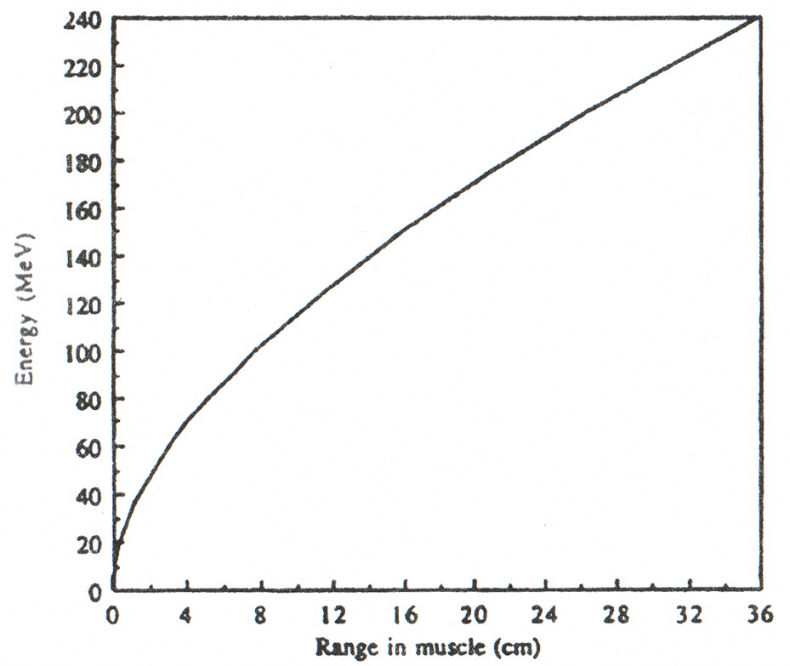
Range of proton beam
Научно-практический центр протонной лучевой терапии и радиохирургии (Москва-Дубна)
The energy of the medical
proton beam is 150 MeV in treatment
room (after decelerating).
150 MeV ⇒ 16cm range in human tissue

Slide 7
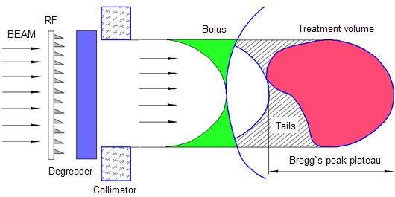
Technique in proton therapy
3D Conformal Proton Therapy Technique
Научно-практический центр протонной лучевой терапии и радиохирургии (Москва-Дубна)
  Field ⇒ projected target contour
  (by Collimator)
  Range ⇒ target distal surface
  (by Bolus and Degrader)
  SOBP ⇒ max target thickness
  (by Ridge Filter)
That method has one disadvantage – healthy tissue fall into 30% “tail” of dose distribution (90-100% if use a single field of irradiation)

Slide 8
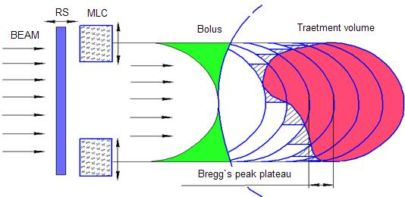
Technique in proton therapy
Dynamic Conformal Irradiation Technique
Научно-практический центр протонной лучевой терапии и радиохирургии (Москва-Дубна)
  Longitudinally divide the target ⇒ slices.
  Conform thin layer of SOBP (minipeak) to each slice ⇒ variable SOBP.
The base of work of RS-MLC system consists of irradiation layer-by layer of all tumor volume.
This technique makes the dose in “tail” field near the tumor smaller.

Slide 9
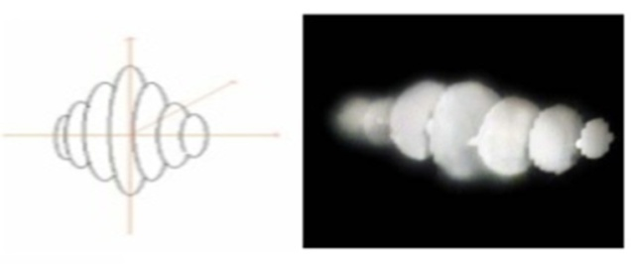
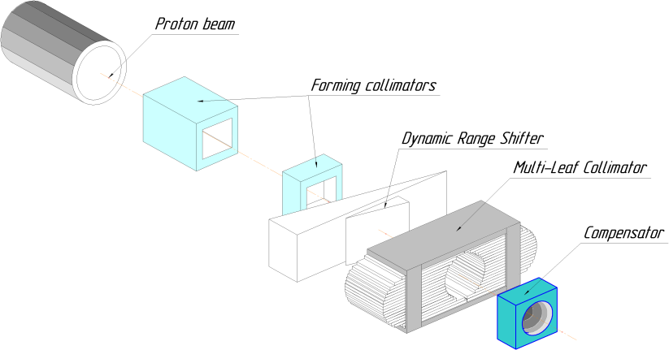
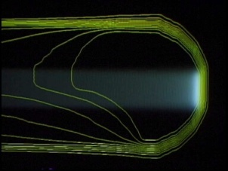
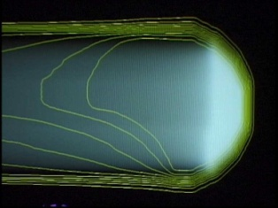
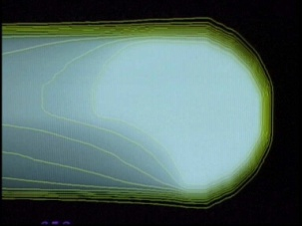
Dynamic Irradiation System
Научно-практический центр протонной лучевой терапии и радиохирургии (Москва-Дубна)
In the dynamic irradiation method,
a target volume is virtually divided
into thin layers in the depth direction
with using new devices as a
Multi-Leaf Collimator and Dynamic Range Shifter
and those individual layers are treated
sequentially with irradiations with a common small SOBP, different beam ranges, and conformal fields.

Slide 10
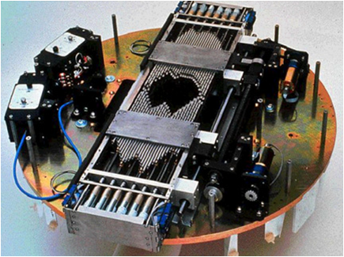
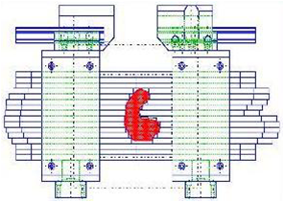
Equipment for Dynamic Irradiation System:
Multi-Leaf Collimator (MLC)
Научно-практический центр протонной лучевой терапии и радиохирургии (Москва-Дубна)
MLC equipped with 60 pairs of leaves has been installed on beam axis.
MLC can change aperture of proton beam automatically.
Leaf material – steel
Number of leaves - 60
Max field size – 100x100 mm
Height of one leaf – 2,9mm
Individual leaf travel – 100mm
Average transmission 3% max

Slide 11
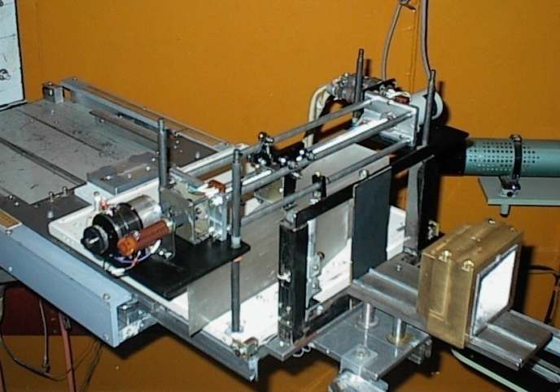
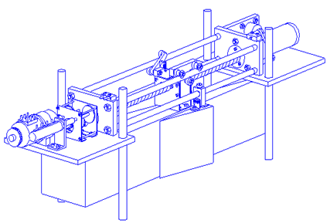
Equipment for Dynamic Irradiation System:
Dynamic Range Shifter (RS)
Научно-практический центр протонной лучевой терапии и радиохирургии (Москва-Дубна)
To change the energy of the therapeutic proton beam step-by-step, the dynamic range shifter is used.
RS consist of two plexeglas wedges, step motor, worm-gear and two independent positioning detector.
Material of degrader – plexiglas
Max thickness on the beam axis – 108mm(H2O)
Output scattering angle of about 17,0mrad or 1,0degree

Slide 12
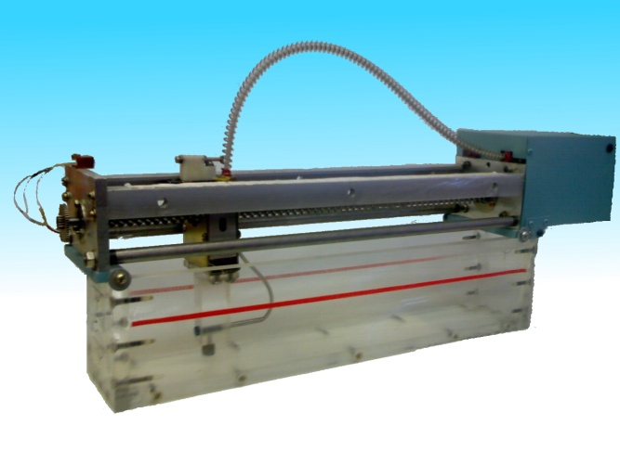
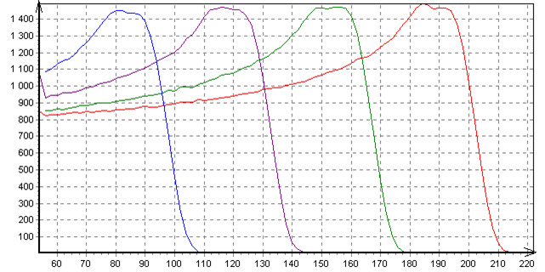
Equipment for Dynamic Irradiation System:
The Device for measurement of a therapeutic proton beam dose distribution
Научно-практический центр протонной лучевой терапии и радиохирургии (Москва-Дубна)
The Device for the proton beam energy control and measurement of its depth-dose curve. The main elements: water phantom for maximum square aperture of proton beam 100*100mm and one axis moving semiconductor detector with maximum travel by 300mm for 200MeV proton beam.
Example of measurement.
Depth-dose curves of different depths in water phantom.

Slide 13
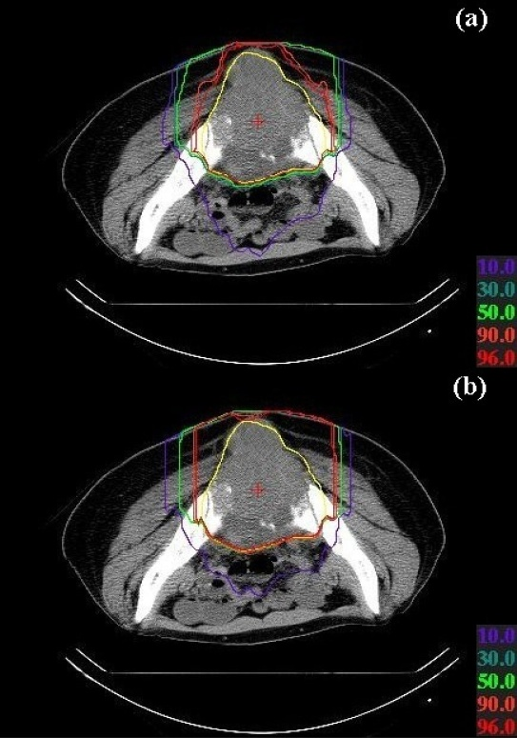
Clinical Effectiveness (expected results)
Научно-практический центр протонной лучевой терапии и радиохирургии (Москва-Дубна)
* Kanematsu et al.: Treatment planning for the layer-stacking irradiation system. | Dose distribution for a tumor in the bone and soft tissue region*; Target contour and the isodose lines are overloaded on the patient CT image for (a) the dynamic irradiation and (b) the conventional irradiation. The yellow line shows the target contour while the isodose lines are in colors of the corresponding dose-percentage numbers shown. Generally effective for large target volume single or a few beam directions small organ motion

Slide 14
Conclusion:
Научно-практический центр протонной лучевой терапии и радиохирургии (Москва-Дубна)
Improvement of dose distribution is expected with the dynamic irradiation method, though the significance may depend on size, shape, location of the tumor, and number of beam directions used to treat the patient.
We expect that the dynamic irradiation method will be routinely used at Medico-Technical Complex JINR in a addition with the conventional method.
In general, addition of the dynamic irradiation method should improve conformity of radiotherapy.
We expect the commissioning of the dynamic delivery system in the near future.

